Slide 1
U.S. Soccer Referee Program Update: Supporting the Youth Game Adrian Garibay Ryan Mooney
Notes:
To add slides with this background right click on image in left pane and choose duplicate slide.

Slide 2
Development Model
Referees
Coaches
Players
Notes:
To add slides with this background right click on image in left pane and choose duplicate slide.

Slide 3
Referee Zones
Zone 3
Professional Referee Organization (PRO)
Zone 2
Referee Identification and Training
Zone 1
Referee Education Resources
Notes:
To add slides with this background right click on image in left pane and choose duplicate slide.

Slide 4
Zone 1 Objectives
Produce referee education resources for approximately 150,000 members
Support and work with State Referee Associations and membership
Update the business practices of the department and the administrative policies of the program
Notes:
To add slides with this background right click on image in left pane and choose duplicate slide.

Slide 5
2013: Emphasis on Youth
Content
Targeted training
Images and audience
Improved tests
Videos
Online learning
Over 580,000 views
Events
Notes:
To add slides with this background right click on image in left pane and choose duplicate slide.

Slide 6
Events
ODP
Camps
Tournaments
Presidents Cup
National Championship Series
Notes:
To add slides with this background right click on image in left pane and choose duplicate slide.

Slide 7
2014: Emphasis Continues
Annual updates
Additional and updated videos
State Referee Association feedback
Focus
Awareness
Assessment
Technology
Notes:
To add slides with this background right click on image in left pane and choose duplicate slide.

Slide 8
Focus: Awareness
ussoccer.com
Resource Center
Monthly updates
Notes:
To add slides with this background right click on image in left pane and choose duplicate slide.

Slide 9
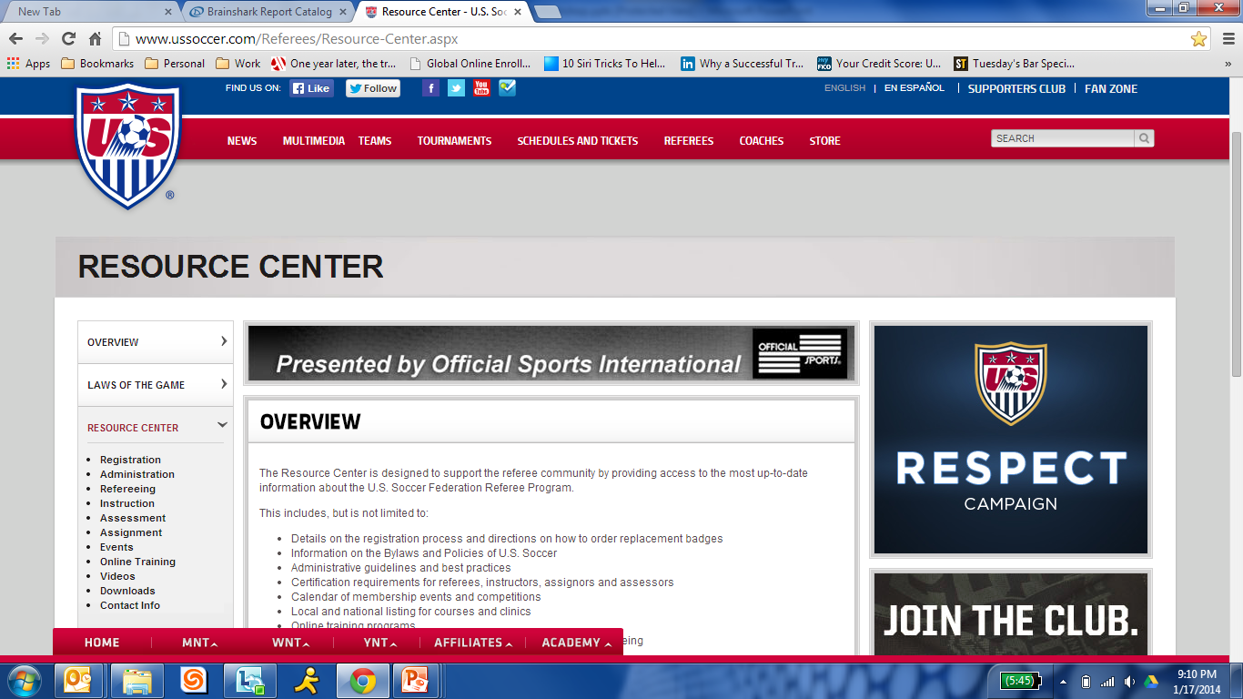
Focus: Awareness
ussoccer.com
Resource Center
Monthly updates
Notes:
To add slides with this background right click on image in left pane and choose duplicate slide.

Slide 10
Focus: Assessment
Admin changes
Purpose
Training
Notes:
To add slides with this background right click on image in left pane and choose duplicate slide.

Slide 11
Focus: Technology
Online learning
Courses
New officials
Upgrading
Recertification
Assignment and assessment
Registration process
Notes:
To add slides with this background right click on image in left pane and choose duplicate slide.

Slide 12
U.S. Soccer Referee Program Update: Supporting the Youth Game Adrian Garibay Ryan Mooney
Notes:
To add slides with this background right click on image in left pane and choose duplicate slide.

