Slide 1
Funding a Field Complex or Major Project
Dave Brown,
Club Development Network
Notes:
To add slides with this background right click on image in left pane and choose duplicate slide.

Slide 2
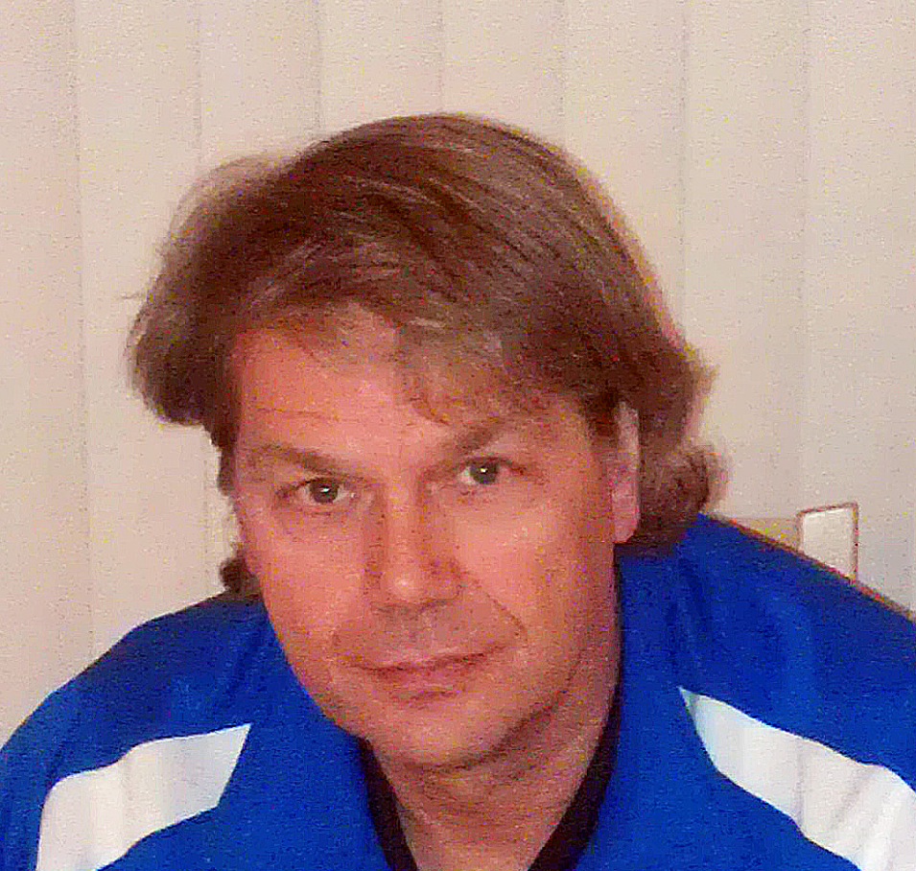
Dave Brown
35 years as a DOC, college, HS and ODP coach plus 25 years grant writing in higher ed and youth services
USSF B license, NSCAA DOC certificate, Master’s Degree in higher education
Notes:
To add slides with this background right click on image in left pane and choose duplicate slide.

Slide 3
Dave Brown Founding Partner | 1002 Aurora Ave North Suite 36 #279 Seattle, WA 98133 (206) 219-9443 x 102 Dave@ClubDevNet.com www.ClubDevNet.com

Slide 4
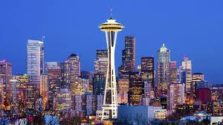
Seattle

Slide 5
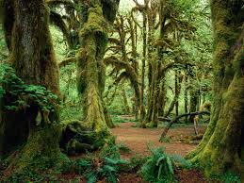
Big Trees

Slide 6
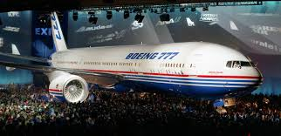
Big Trees
Big Planes

Slide 7
Big Forests
Big Planes
Big Computers

Slide 8
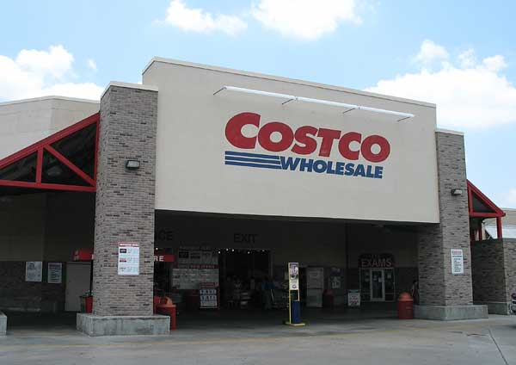
Big Forests
Big Planes
Big Computers
Big Stores

Slide 9
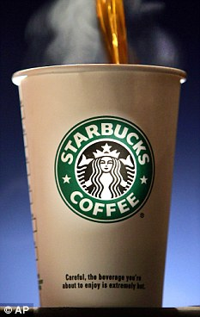
Big Forests
Big Planes
Big Computers
Big Stores
Big Coffee

Slide 10
Big Forests
Big Planes
Big Computers
Big Stores
Big Coffee
Big Foundations

Slide 11
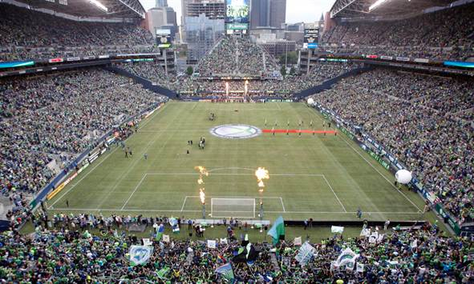
Big Soccer Crowds
Big Coffee

Slide 12
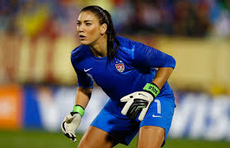
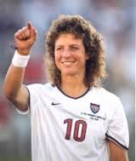
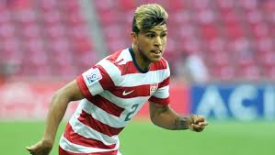
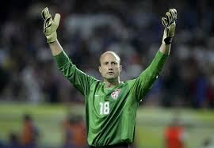
Big Players

Slide 13
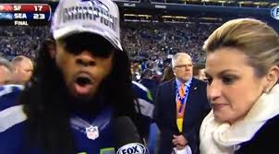
Big Mouths

Slide 14
Capital Campaign
Capital - Most applicable and our focus today.
Definition: Raises funds to acquire or improve a physical asset. Most commonly for the purchase, construction, renovation or equipping of a building (“bricks and mortar”.)
The power of a Capital Campaign is beyond just money; has the power to transform an organization.

Slide 15
“Comprehensive” Campaign
Can include capital projects, operating funds, endowment and scholarship/financial aid.
Harvard launches $6.5 billion capital campaign
Report says Stanford is first university to raise $1 billion in a single year
Northwestern announces $3.75 billion fundraising campaign
The Campaign for Oregon State University - $1 billion

Slide 16
What’s Involved?
Strategic and shared mission
Organizational strength and continuity
Patience – including ability to handle local politics, zoning, mitigation costs, neighborhood concerns
Commitment to planning
Willingness to seek and take advice
Notes:
What will you need to be successful?

Slide 17
Where will funds come from?

Slide 18
Sources
Individuals
Private Foundations
Corporate Donors and Sponsors
Public Sources

Slide 19
Major Gifts from Individuals
What qualifies as a major gift varies by community and the project.
Could $5,000, $25,000, $100,000 or more.
Often paid over a 3-year pledge period. May come in form of appreciated assets, real estate, equipment, etc.
60% of gifting decisions are made by women and the majority are over age 60.
Avoiding the pre-emptive or “go-away” gift.

Slide 20
Motivations - Individual Giving
Feel good about and trust those that are asking.
Will or have benefited directly – through children, grandchildren, etc. – through the project or the organization.
Altruism, good citizenship: Support worthy community projects.
For social and acceptance reasons. Don’t want to feel “left out” when others they know and care about are supporting a worthwhile project. May be part of a family tradition.
Tangible: tax implications, naming and other recognition, to change other’s perception of them.
They were asked!

Slide 21
Charitable Foundations
Nature and motivation:
Required to give money away
To honor & further the mission of the founders or current family or governing body
To effect social change

Slide 22
Foundation Basics - Types
Operating: supports the one charity it was set up for
Corporate: only the largest corporations have separate foundations
Community; community foundations pool donations into a coordinated investment and grant making facility dedicated primarily to the social improvement of a given community. Rise in Donor Advised funds
Family/Independent: most common

Slide 23
Giving by Foundation Type

Slide 24
Types of Foundation Funds
Capital
Project/Program
Scholarship/participation fees
Capacity Building/Startup
Operating
Endowment

Slide 25
Corporate Donors and Sponsors
Nature and motivation: marketing vs philanthropic budgets and local vs regional/national budget
“Strategic Partnerships” or WIIFM?:
to enhance the bottom line
to enhance or repair a public image
to boost employee morale
to enhance CEO or board image
be associated with a project or demographic group

Slide 26
Public Sources
HUD & Community or Economic Investment funds
Congressional allocations
Other Federal grants
Public bonds
Typically beyond the scope of a soccer organization on its own but great partnership potential.

Slide 27
5 Key Elements of a Successful Capital Campaign
1. Compelling and Urgent Need
Congruent with organizational mission statement, of perceived value and with an element of urgency

Slide 28
5 Key Elements of a Successful Capital Campaign
2. Committed Volunteer Leadership
Chair or Co-Chairs, committee membership and leadership, board, staffing.
Well-connected, well-equipped, and with time, energy and resources to commit.
Other: Campaign Cabinet, Steering Committee, Honorary chair, Advisory committee, Emeritus group, Honorary spokesperson, etc.

Slide 29
5 Key Elements of a Successful Capital Campaign
3. Adequate Prospect Pool
With ability and inclination to give.
Connection + level of emotional investment = greater level of support.

Slide 30
5 Key Elements of a Successful Capital Campaign
4. Plan – Infrastructure – People and Financial Resources

Slide 31
5 Key Elements of a Successful Capital Campaign
5. Well-articulated Case Statement & marketing effort; both external and internal

Slide 32
Capital fundraising – art or science?
Both, but some principles are immutable:
Sequential Giving: “Raising funds from top down and inside out; the largest gifts and the closest to the organization first.”
Very hard to be successful without early and large gifts – Standard Gift Chart. 80/20 Rule.
Where do “grassroots” fundraising, challenge/matching and workplace giving fit into a campaign?

Slide 33
What expenses beyond construction might be part of our campaign?
Replacing operating funds lost to campaign
Scholarship, other on-going costs
“Soft Costs”: Engineering, campaign expense, permitting, legal fees, moving expenses, interim financing, etc.
Construction overruns, other unforeseen

Slide 34
Timing and Phases Example
STAGE I: Planning, Organization & Discovery
STAGE II: Leadership (largest) Gifts
STAGE III: Major Gifts
STAGE IV: Community (smaller) Gifts & Campaign
STAGE V: Campaign Close and Celebration

Slide 35
Red Flags and Fallacies
Drive can be completed with “other people’s” money
“$1,000 x 1,000 donors equals $1 million”
Businesses and foundations will fund the entire campaign.
Can’t we start to build and raise funds later?
Rental and future income will pay for the entire project.

Slide 36
Funder Questions
Project Funding: Lead gifts, board and leadership giving (total projected amount; % of those giving), staff giving, plans for remainder. Who else are you asking?
Sustainability: Maintenance, increased operating costs (if applicable), revenue projections
Resources: staffing, funding, infrastructure, campaign budget, etc.
Organizational history: longevity, indicators of success and stability, reputation, who’s on your board or committee

Slide 37
Importance of Policies in Advance
Gift acceptance
Naming & Recognition
How to fund start-up costs – feasibility, fundraising, engineering, permitting – before campaign funds begin to come in.

Slide 38
Other Questions
Feasibility Study
Quiet and public phases
Consultant fees; how and how much
Impact on staff
Pavers, special events, and other small gifts
Should we apply to the US Soccer Foundation?
Notes:
US Youth Soccer grants are on hiatus now.

Slide 39
References
Capital Campaigns: A Guide for Board Members and Others Who Aren’t Professional Fundraisers but Who Will Be the Heroes Who Create a Better Community, Grover PhD, Stuart.
The Soccer Field Handbook (CD-ROM), US Soccer Foundation
FieldTurf Field Building Handbook
Synthetic Turf Council; Attracting Funding & Local Support for a Synthetic Turf Field
Astroturf.com
Blackbaud Gift Range Calculator www.blackbaud.com/nonprofit-resources/gift-range-calculator

Slide 40
Questions?
Notes:
To add slides with this background right click on image in left pane and choose duplicate slide.

Slide 41
Dave Brown Founding Partner | 1002 Aurora Ave North Suite 36 #279 Seattle, WA 98133 (206) 219-9443 x 102 Dave@ClubDevNet.com www.ClubDevNet.com

