Slide 1
Improving Communications
Using tools (at little to no cost) to facilitate information sharing with Instructors and improve communications with the Referee Community.

Slide 2
Facebook
Facebook – approx. 350 referees have joined the closed “IA Soccer Referees” Group since it was created in Jan. ’12. We're using this to reach our younger referees.
https://www.facebook.com/groups/255595024498710/
Ex.: Q. & A., Discussion, Articles, Pictures, Video, Announcements, … .

Slide 3
Dropbox
Dropbox – utilized to share media/presentations, clinic information, exams, forms, publications, … . (The SDI Dropbox allows each Instructor a minimum 2 GBytes of storage.)
https://www.dropbox.com/
Ex.: Presentations, Exams, Forms, Video, unZipped Courses, … .

Slide 4
MaxBulk Mailer
MaxBulk Mailer – mass e-Mail distribution system used to communicate LOTG changes/POE, registration information, and bi-monthly “Whatcha gonna do?” Q.&A. to the IA referee community.
http://www.maxprog.com/site/misc/products_us.php
Ex.: Quizzes, News, Announcements, LOTG POE, … .

Slide 5
Brainshark
Brainshark – contains the on-line referee recertification materials. The tool has also been used to enable State Cup referees to receive just-in-time on-line training of Cup points-of-emphasis with an associated quiz.
http://www.brainshark.com/
Ex.: JIT On-line Training, Recertification, … .

Slide 6
EasyTestMaker
EasyTestMaker – for on-line testing, utilized for those wanting to upgrade from 8 to 7 or 7 to 6, and also used in conjunction with on-line Brainshark recertification. (Classroom testing is of course still done widely.)
http://www.easytestmaker.com/default.aspx
Ex.: Entry-Level Exam, State Exam, Recertification Exam, Quizzes, … .

Slide 7
SurveyMonkey
SurveyMonkey – to collect follow-up information from Clinic participants as to their impressions of and satisfaction with courses/instructors.
http://www.surveymonkey.com/
Ex.: Post Clinic Follow-up, Referee Association Needs Surveys, … .

Slide 8
AnyMeeting
AnyMeeting – to share Instructor desktops in order to collaborate on presentation materials.
http://www.anymeeting.com/
Ex.: Collaboration / Co-development of instructional materials, … .

Slide 9
R. C. (Chip) Walaska
SDI, Iowa
rcwalaska@mchsi.com

Slide 10
Questions
?

Slide 11
Improving Communications (Screen Shot Backup Slides)
Using tools (at little to no cost) to facilitate information sharing with Instructors and improve communications with the Referee Community.

Slide 12
Facebook
Facebook – approx. 350 referees have joined the closed “IA Soccer Referees” Group since it was created in Jan. ’12. We're using this to reach our younger referees.
https://www.facebook.com/groups/255595024498710/
Ex.: Q. & A., Discussion, Articles, Pictures, Video, Announcements, … .

Slide 13
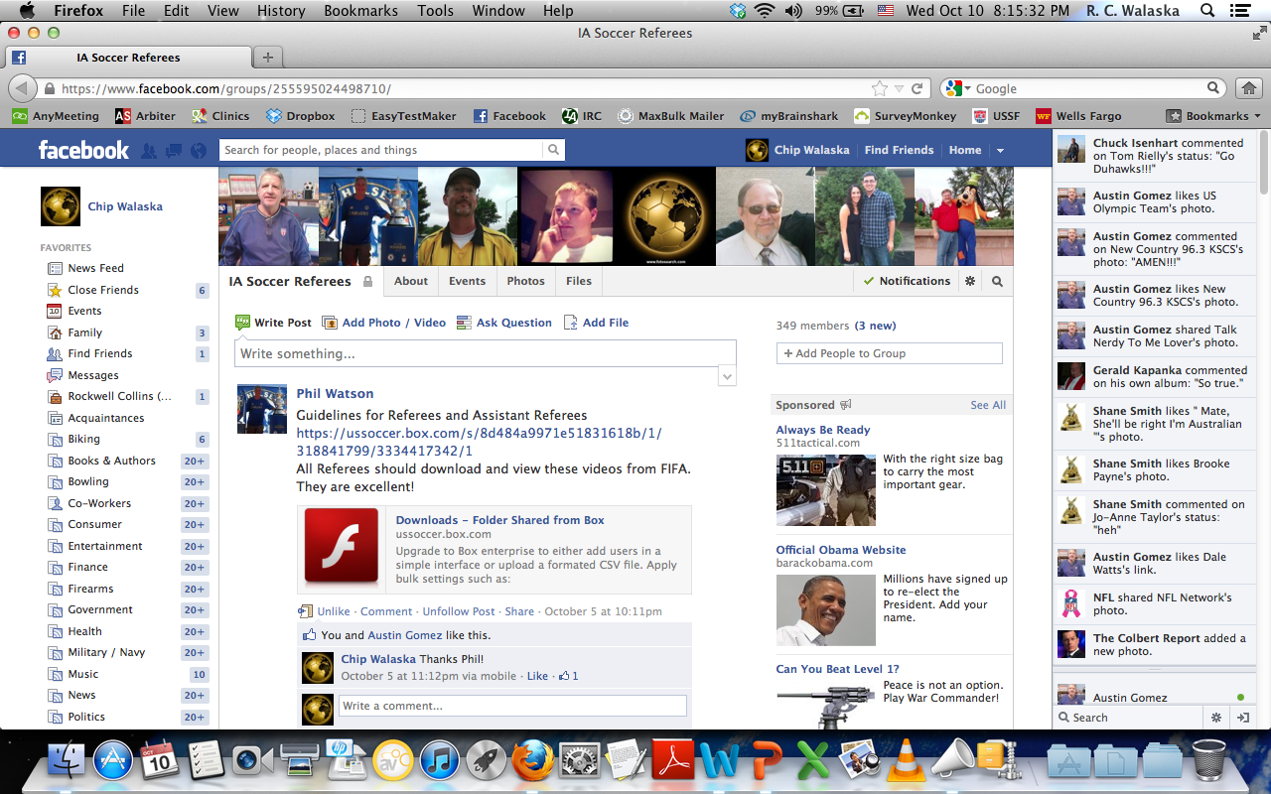

Slide 14
Dropbox
Dropbox – utilized to share media/presentations, clinic information, exams, forms, publications, … . (The SDI Dropbox allows each Instructor a minimum 2 GBytes of storage.)
https://www.dropbox.com/
Ex.: Presentations, Exams, Forms, Video, unZipped Courses, … .

Slide 16
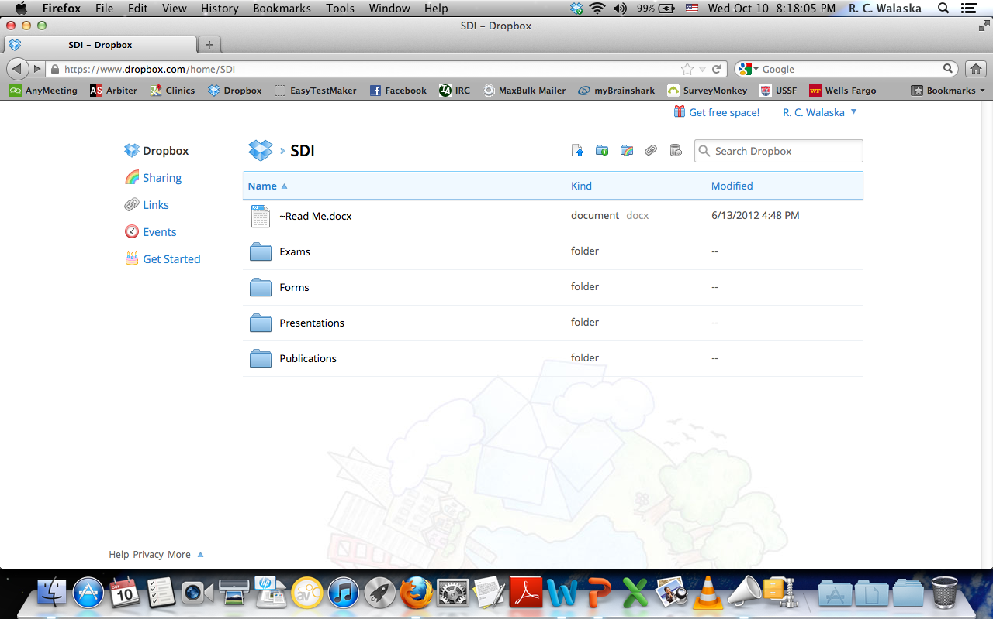

Slide 17
MaxBulk Mailer
MaxBulk Mailer – mass e-Mail distribution system used to communicate LOTG changes/POE, registration information, and bi-monthly “Whatcha gonna do?” Q.&A. to the IA referee community.
http://www.maxprog.com/site/misc/products_us.php
Ex.: Quizzes, News, Announcements, LOTG POE, … .

Slide 18
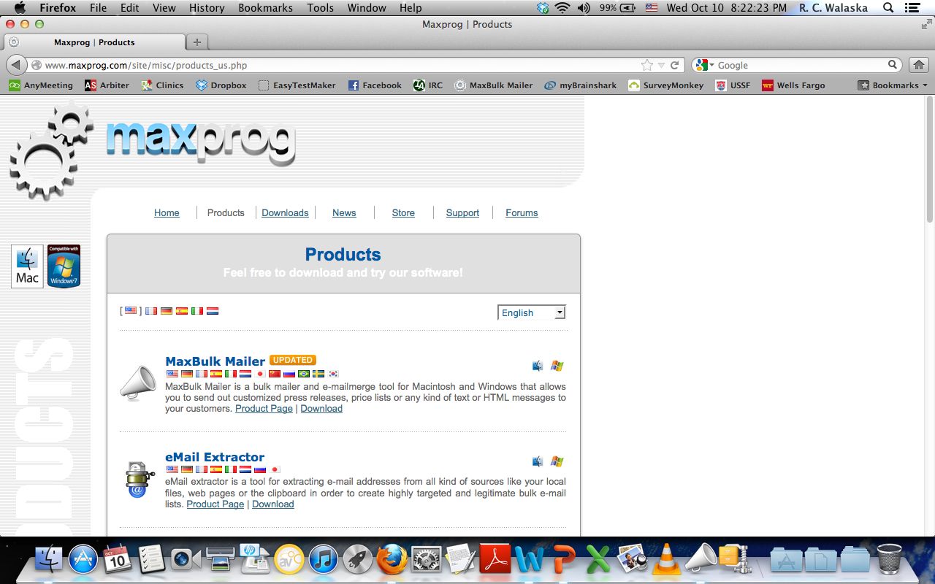

Slide 19
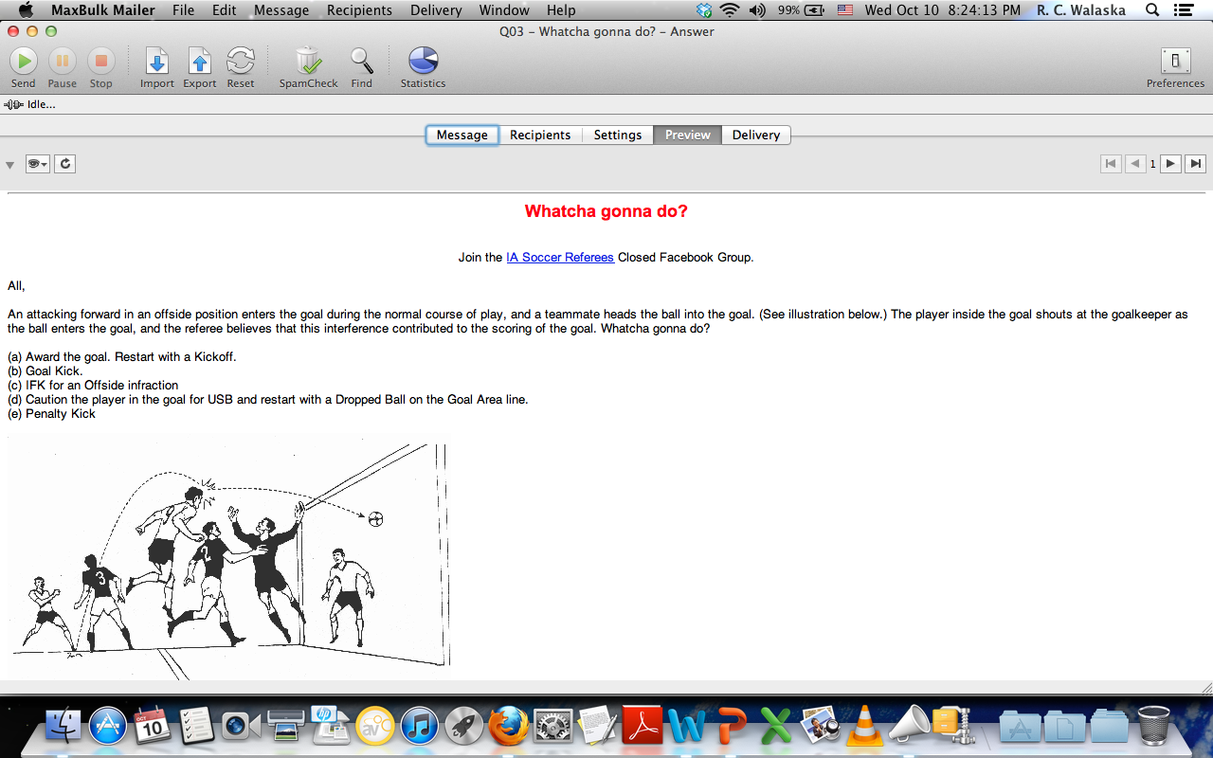

Slide 20
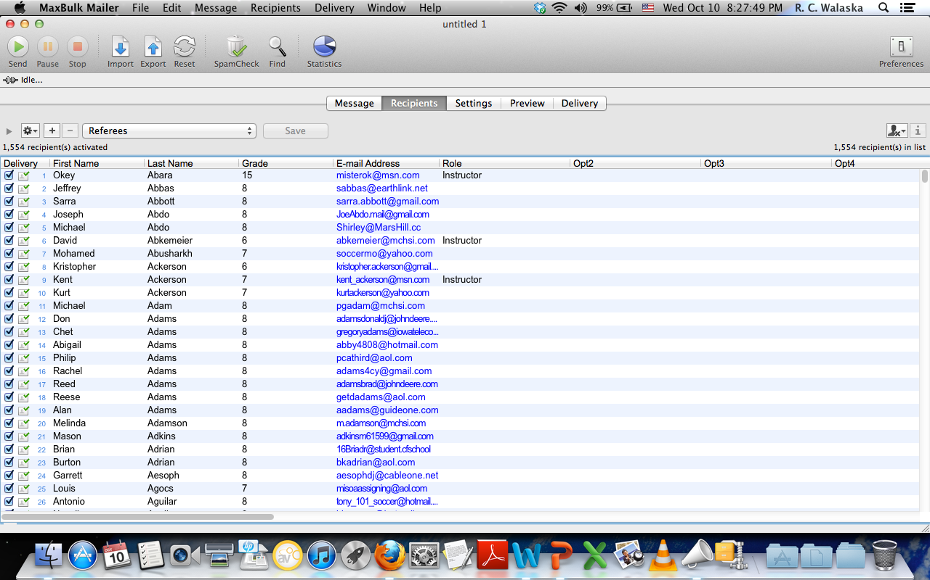

Slide 21
Brainshark
Brainshark – contains the on-line referee recertification materials. The tool has also been used to enable State Cup referees to receive just-in-time on-line training of Cup points-of-emphasis with an associated quiz.
http://www.brainshark.com/
Ex.: JIT On-line Training, Recertification, … .

Slide 22
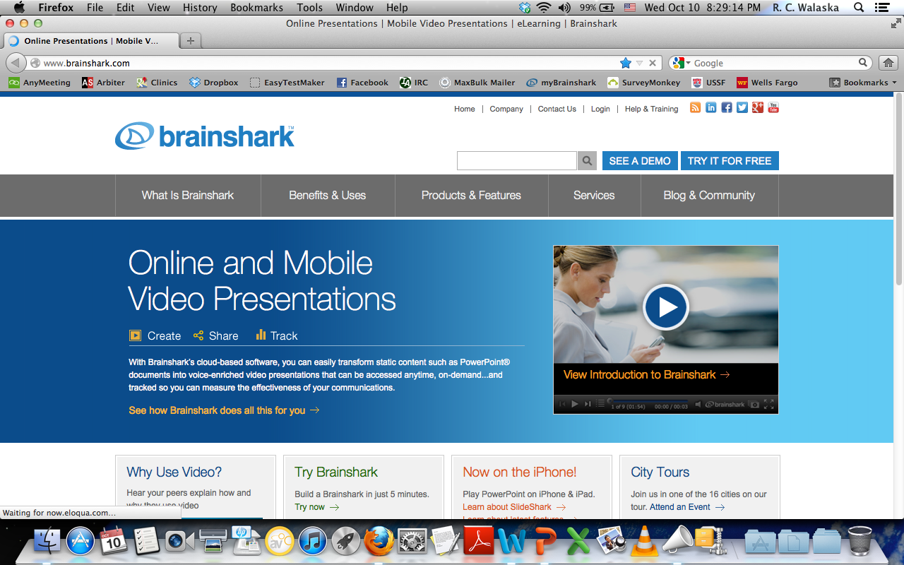

Slide 23
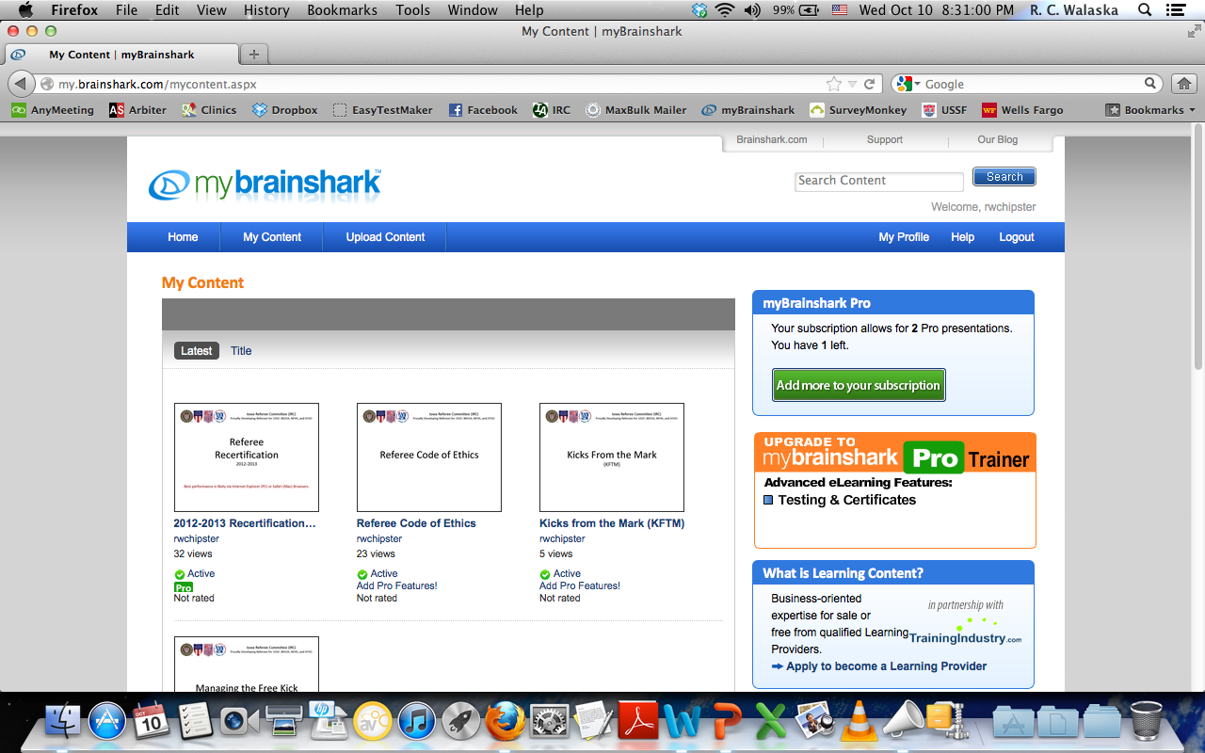

Slide 24
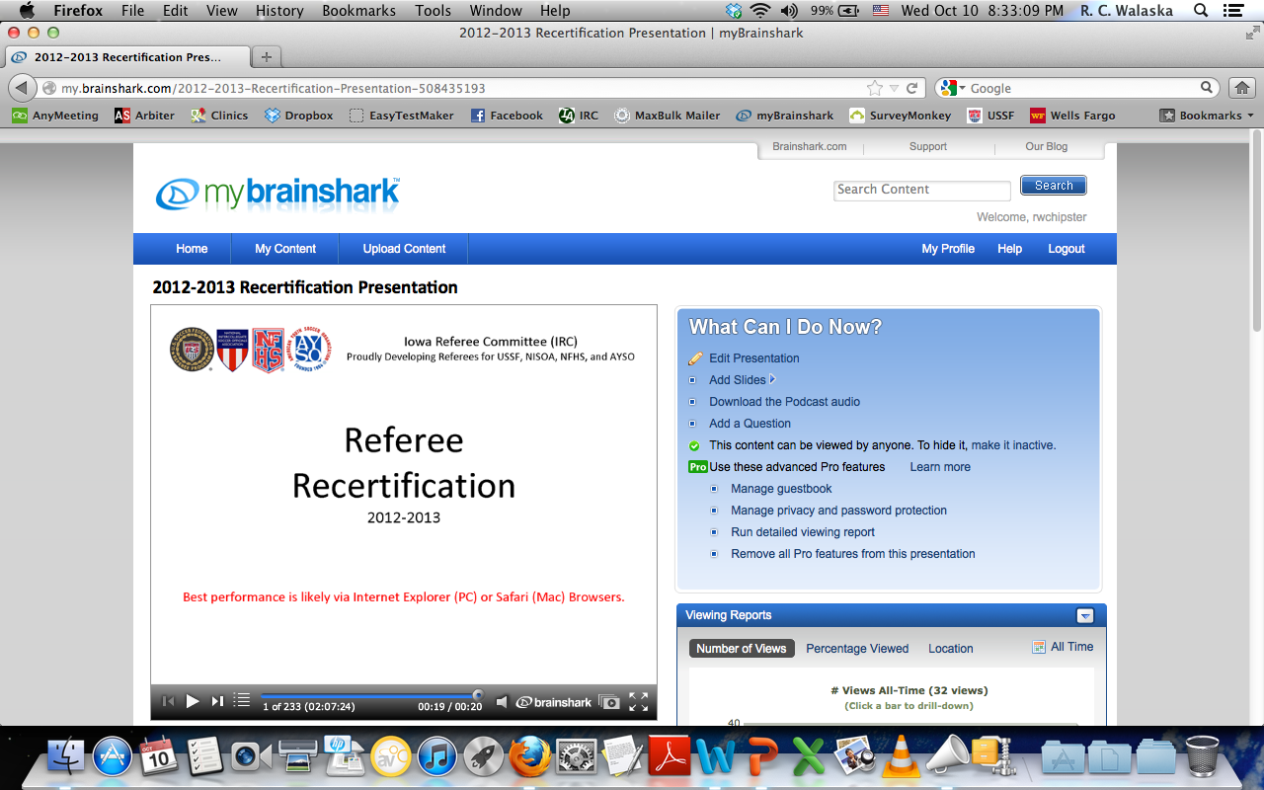

Slide 25
EasyTestMaker
EasyTestMaker – for on-line testing, utilized for those wanting to upgrade from 8 to 7 or 7 to 6, and also used in conjunction with on-line Brainshark recertification. (Classroom testing is of course still done widely.)
http://www.easytestmaker.com/default.aspx
Ex.: Entry-Level Exam, State Exam, Recertification Exam, Quizzes, … .

Slide 26
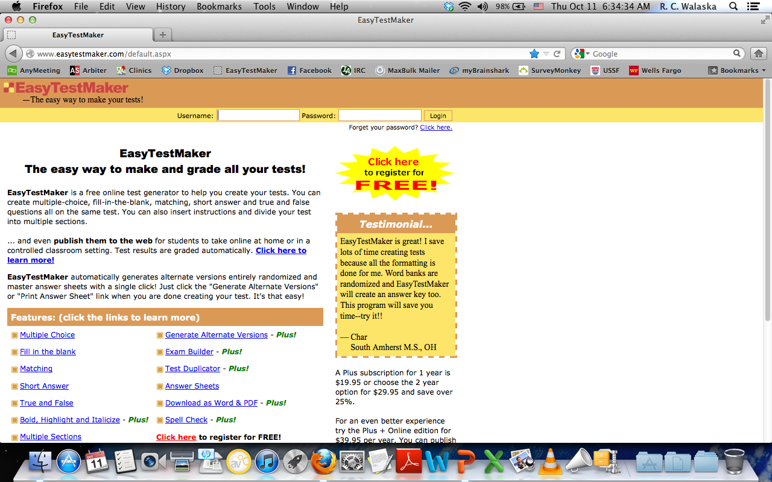

Slide 27
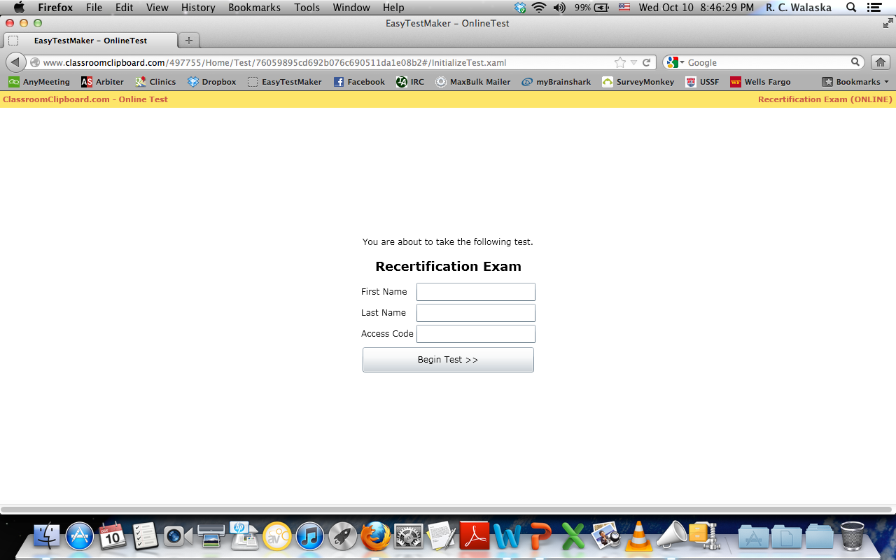

Slide 28
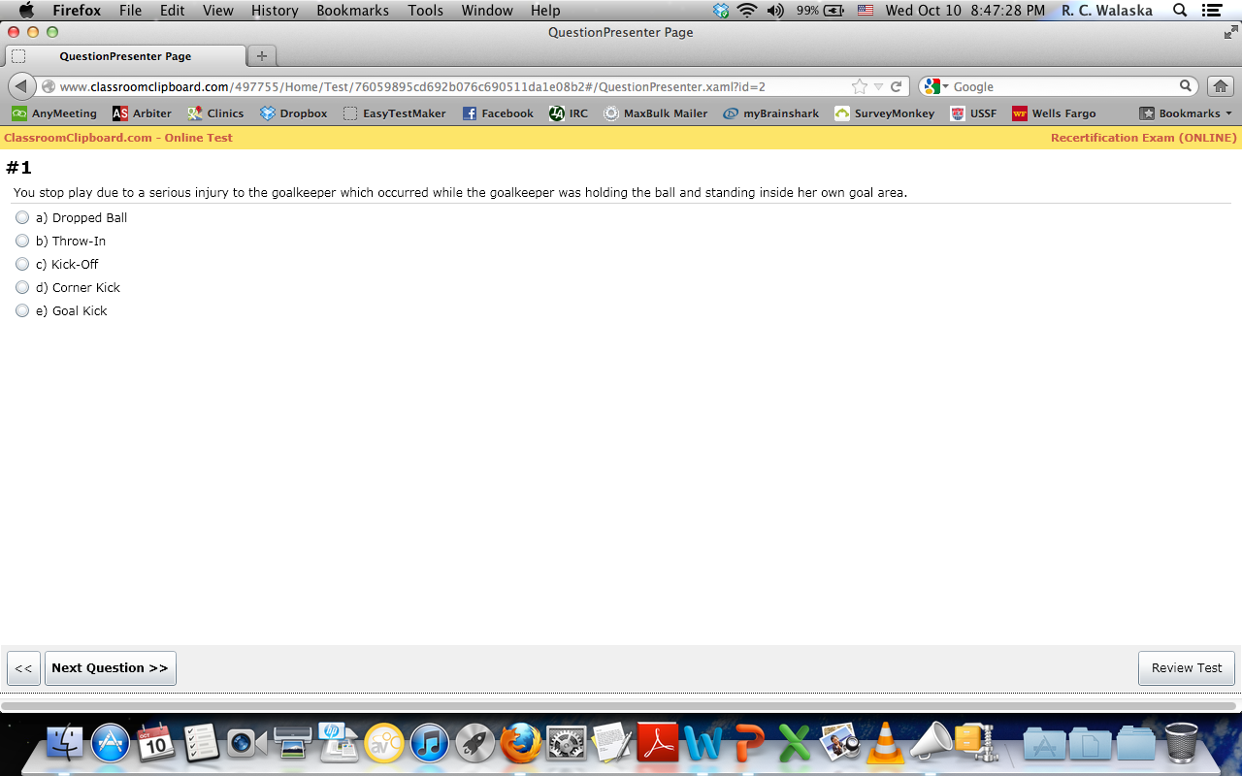

Slide 29
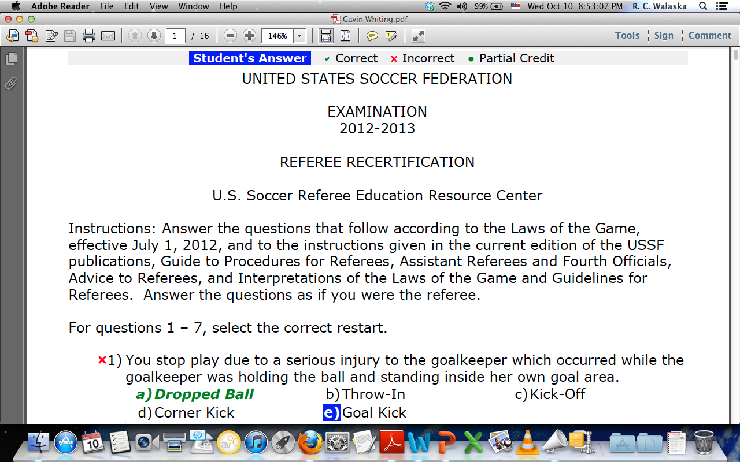

Slide 30
SurveyMonkey
SurveyMonkey – to collect follow-up information from Clinic participants as to their impressions of and satisfaction with courses/instructors.
http://www.surveymonkey.com/
Ex.: Post Clinic Follow-up, Referee Association Needs Surveys, … .

Slide 31
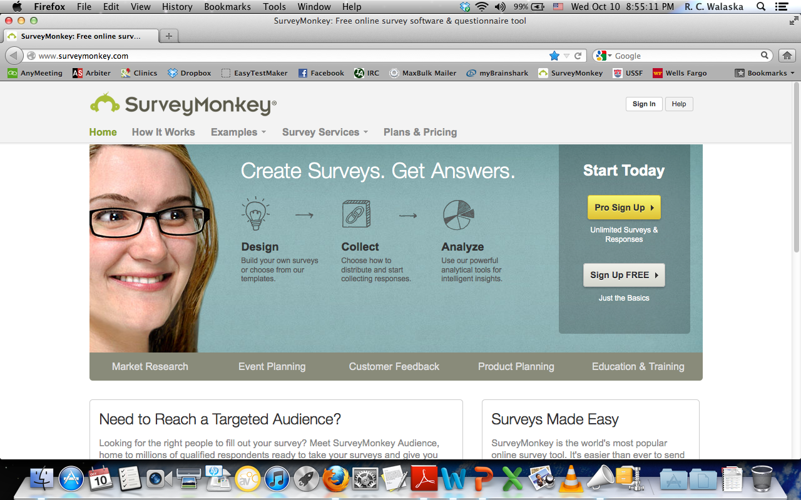

Slide 32
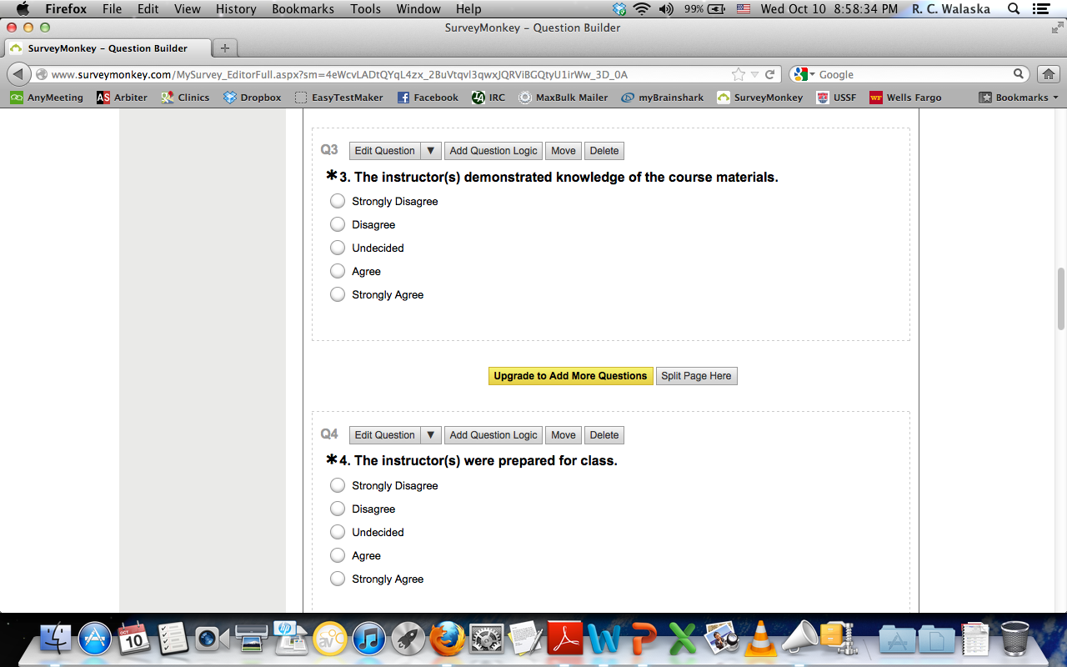

Slide 33
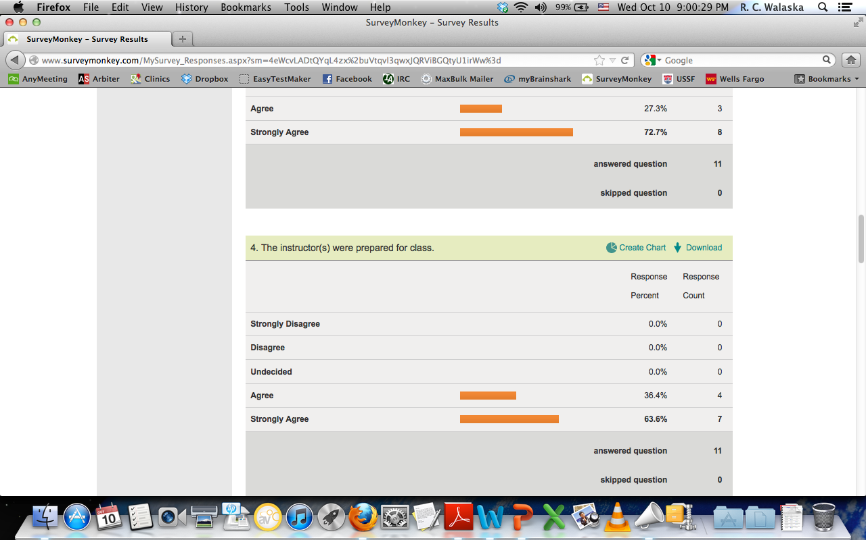

Slide 34
AnyMeeting
AnyMeeting – to share Instructor desktops in order to collaborate on presentation materials.
http://www.anymeeting.com/
Ex.: Collaboration / Co-development of instructional materials, … .

Slide 35
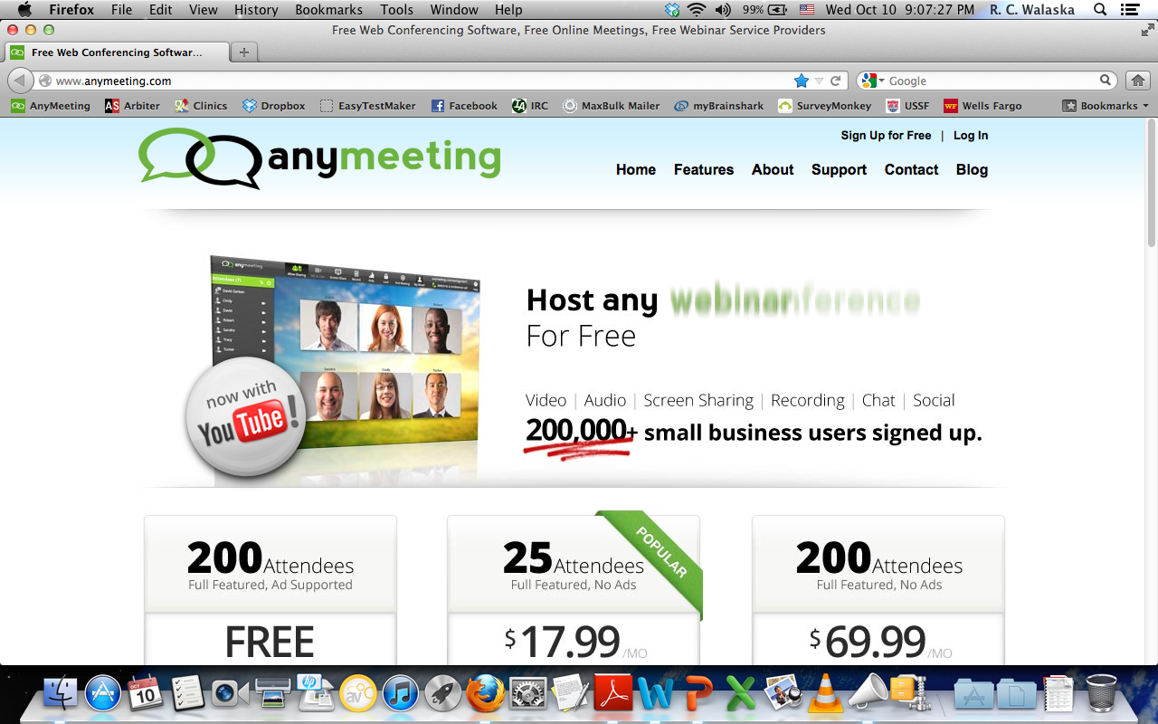

Slide 36
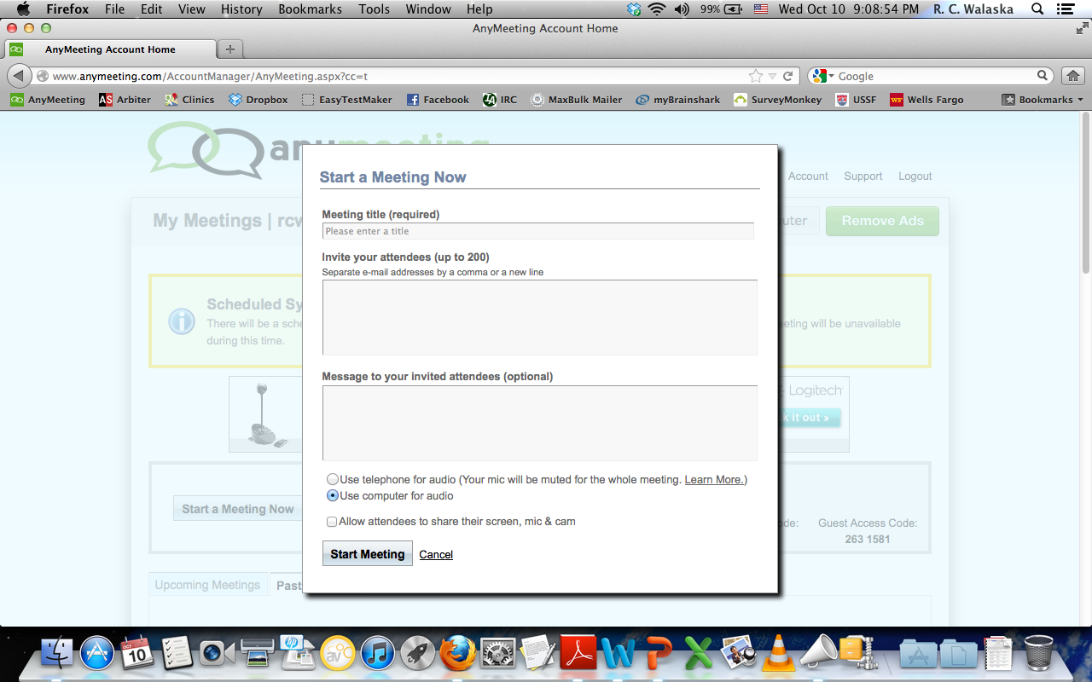

Slide 37
R. C. (Chip) Walaska
SDI, Iowa
rcwalaska@mchsi.com

Slide 38
Questions
?

