Slide 1
Locating and Approaching Sponsors
Dave Brown,
Club Development Network
Seattle, WA
Notes:
To add slides with this background right click on image in left pane and choose duplicate slide.

Slide 2
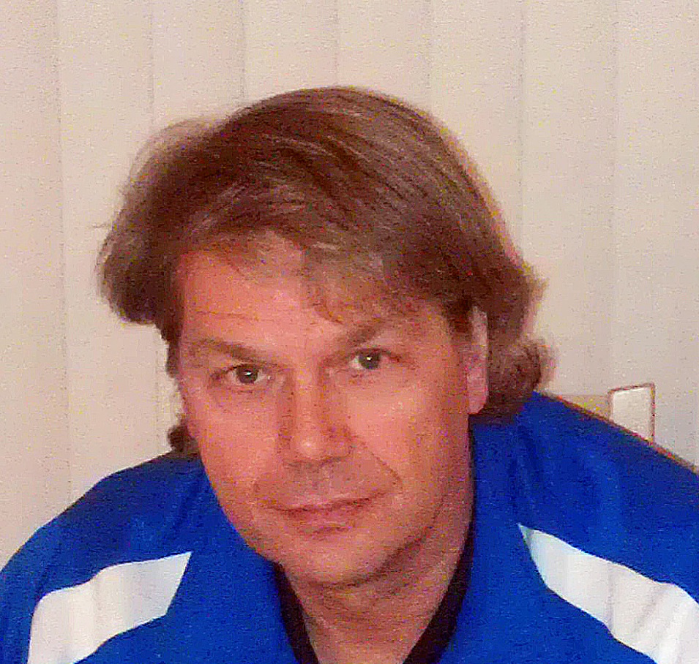
Dave Brown
35 years as a DOC, college, HS and ODP coach plus 25 years fundraising in higher ed and youth services
USSF B license, NSCAA DOC certificate, Master’s Degree in higher education
Notes:
To add slides with this background right click on image in left pane and choose duplicate slide.

Slide 3
Dave Brown Founding Partner | 1002 Aurora Ave North Suite 36 #279 Seattle, WA 98133 (206) 219-9443 x 102 Dave@ClubDevNet.com www.ClubDevNet.com

Slide 4
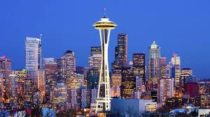
Seattle

Slide 5
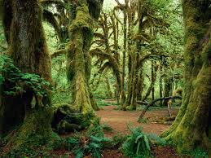
Big Trees

Slide 6
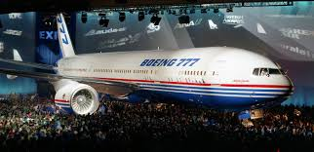
Big Trees
Big Planes

Slide 7
Big Forests
Big Planes
Big Computers

Slide 8
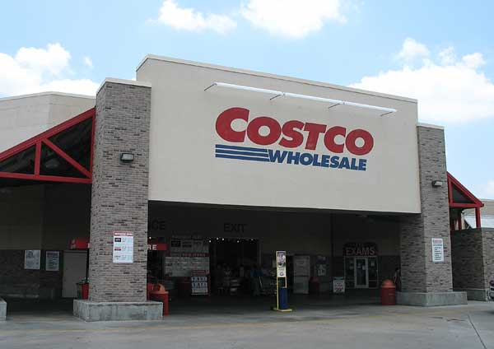
Big Forests
Big Planes
Big Computers
Big Stores

Slide 9
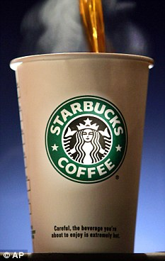
Big Forests
Big Planes
Big Computers
Big Stores
Big Coffee

Slide 10
Big Forests
Big Planes
Big Computers
Big Stores
Big Coffee
Big Foundations

Slide 11
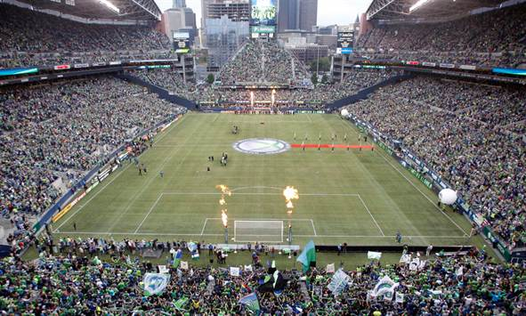
Big Soccer Crowds
Big Coffee

Slide 12
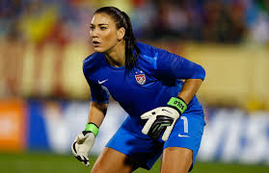
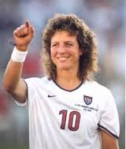
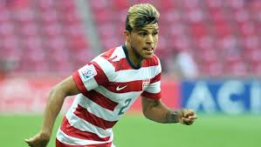
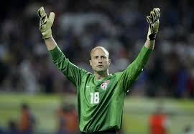
Big Players

Slide 13
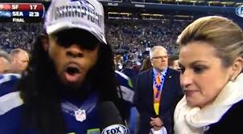
Big Mouths

Slide 14
Sponsorship Basics
Is sponsorship right for your club?
A great time for youth soccer sponsorship
Profile of the sport: WC 2014 and 2015
Demographics: Parents, grandparents, kids, young consumers.
For better or worse, soccer families tend to have more disposable income, better educated, consumers (life stage changes)
Notes:
Presentation focused on club soccer but principles are applicable to a league, college, high school or semi-pro club.
Soccer demographics info sources at end of handouts.

Slide 15
What can sponsorship funds be used for?
Good news - unlike charitable grant funds, most anything. Dollars are fungible.
“Nearly any discrete endeavor can be pulled from a general budget and packaged, such as underwriting six months of a scoutmaster’s service to 20 inner-city children…or sponsor an education outreach program enriching the lives of 100 students, etc.”
Tony Poderis

Slide 16
Sponsorship Funds Can Requested for and Applied To:
Signage/placement: field complex, fields, shelters, bleachers, clubhouse, uniforms, bags, shelters and benches, warm-up tops, warm-up t-shirts, etc.

Slide 17
Sponsorship Funds Can Requested for and Applied To:
Media: website, newsletter, official communications with families, registration forms, etc.
Getting into the homes, hands and heads of prospective customers is valuable in this day of media saturation.

Slide 18
Sponsorship Funds Can Requested for and Applied To:
Events, programs, people: scholarships, tournaments, goalkeeper training, college relations program, SAT prep, skills training, injury prevention/SAQ program, club night, annual meeting, Soccer for Success, TopSoccer or community outreach program, youth/seniors, boys/girls, Academy, coaching education, etc.

Slide 19
Understanding Sponsors
“Ask not what sponsors can do for you, but what you can bring to a sponsor.”

Slide 20
“Strategic Partnerships” or WIIFM?:
to enhance sales
to enhance or repair a public image
to boost employee morale
to enhance CEO or board image
to be associated with a mission or cause

Slide 21
Marketing vs. Philanthropic Funds

Slide 22
The Business Sweet Spot
Multinational Corporation (no connection)
Large chain with local presence but headquarters in another state (no connection)
National company with plant or hub in your area
Large public corporation with history of sponsorship you have a strong connection to
Large privately owned business you have strong connection to
Medium privately owned business you have strong connection to
Franchise owner – multiple stores or region
Franchise owner – one large successful unit
In-kind donation of true value
Start up Business: (Single person landscaping vs venture capital backed high tech in competitive market)
New business/brand entering a crowded market
Single franchise owner – new or small
Mom & Pop business

Slide 23
Identifying Prospects: Sample sponsor list from large Greater Seattle area club:
Windows Phone (jersey sponsor)
Redapt data center infrastructure and cloud solutions
XXX Soccer Stores
Nike
XXX Health Orthopedic
XXX Mortgage
Notes:
Club is in a position of strength; size, history of success and visibility, geography, demographics

Slide 24
Sample List Continued
XXX Healthcare (BROKERS)
Enterprise rental cars
Alaska Airways
XXXX Consulting - business and technology consulting firm
Waste Management
Honda of XXX

Slide 25
Sample List Continued
Final Touch Detailing
XXX Toyota
XXX Dentistry
XXX Construction
XXX Law Firm
XXX Marine - boats
Alaska Salmon Adventures

Slide 26
Sample List Continued
XXX Photography
XXX Physical Therapy
XXX Home Medical
Max Muscle Nutrition
XXX Ridge Physical Therapy
XXX Windermere Real Estate
XXX Windermere Real Estate (2)

Slide 27
Sample List Continued
Yogurt Land
XXX Software - Digital Marketing and Analytics solutions
XXX (RESTAURANT) on Main street
Ristorante Paradiso
Grand Events Rental
XXX Real Estate
XXX Sports Chiropractic

Slide 28
Other Categories:
Cable & Dish Providers
Local Bottlers
Hotels
Popular Tourist Destinations
Anything where people have a choice.
Notes:
No Apple computers. Why not Subway sandwiches? What happened to Olive Garden?

Slide 29
Internal Preparation
Getting your ducks in a row….or, you have one chance to make a good first impression.
Internal planning and communication is as important as external relations.
Questions you should be able to answer and your elevator speech.

Slide 30
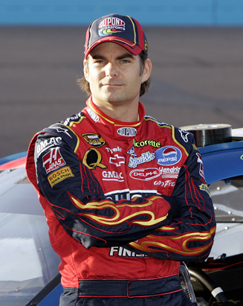
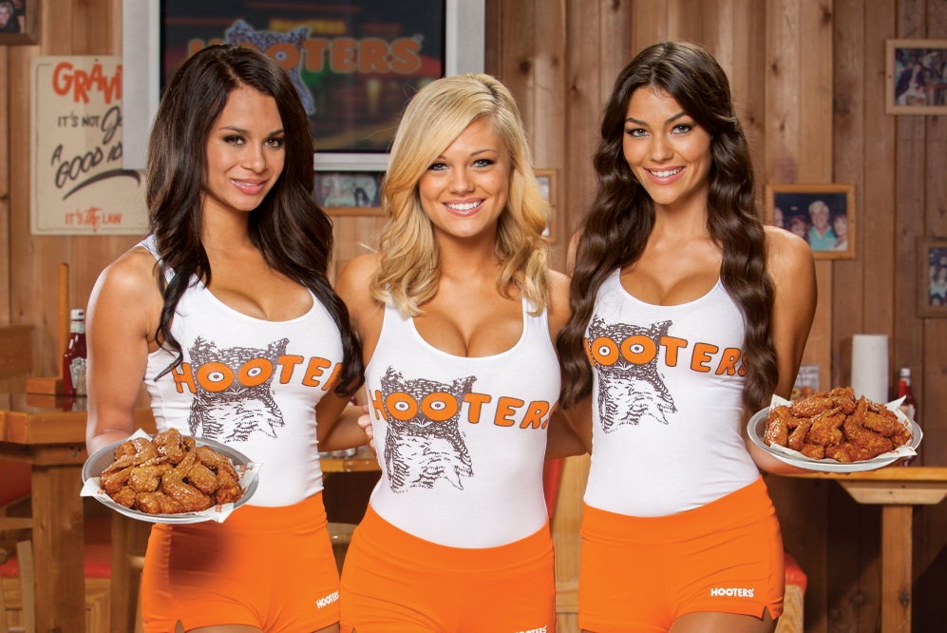
Policies set and documented up front!
Notes:
To add slides with this background right click on image in left pane and choose duplicate slide.

Slide 31
Internal Preparation
What Do We Do that’s Sponsor-Worthy?...or what in your program or organization can be sponsored?
Performing an Asset Inventory: dissect and quantify your properties: programs, projects, people, media and events

Slide 32
Traditional vs. Underserved Programs
Urban Program Strengths
Traditional Program Strengths
Attractive consumer demographics
Business owners – executives in club
Connections through parents
More control over properties – uniforms, facilities, shelter signage, etc.
Compelling participant demographics
Compelling need & story
Partnerships – including national affiliations
United Way – Day of Caring
“Annual report factor”
Notes:
To add slides with this background right click on image in left pane and choose duplicate slide.

Slide 33
Research Objectives
Connections
Prospect’s marketing and sales objectives
New initiatives, target audience(s)
Current sponsorship
Operational areas / geography

Slide 34
Research Tools
Google/Google Advanced Search/ Google Alerts
LinkedIn
Top 100 business lists
Facebook
Commercial tools: Does someone in your club have access to them? LexisNexis may be available through your public library, one of your board member’s work, etc.

Slide 35
Basic Google Search
Google – for corporate websites, annual reports, local news clippings, contact names:
Name of company
+
terms
“community”, “community giving”, “social responsibility”, “giving”, “grants”, “sponsorship”, “philanthropy”, “annual report”
Notes:
Corporate giving/community relations officer will almost always be in the “grip and grin” photo.

Slide 36
How to Discover and Create Connections
Families, managers, board members, coaches
Types of connections: business (their own and B2B relationships), work and Rotary, etc. social, church, reading clubs, golf, tennis, skiing partners, etc…)
Don’t expect your board or other volunteers – to offer up or even know – without prompting and follow-up.

Slide 37
Approach: Your goal is a warm call; never a cold call

Slide 38
Contacting Sponsors - WHO
Local vs. national or regional budget
Corporate Foundation Staff (in a large corporation)
Community Relations Officer (medium-size company)
HR department/CEO’s executive assistant/secretary (small company)
Owner/CEO/CEO’s executive assistant/secretary (small to medium business)

Slide 39
Contacting Sponsors – WHEN
Typically budgets set by January, but sometimes quarterly or semi-annual requests allowed.
Also funds maybe left over at end of fiscal year.

Slide 40
Managing Prospects
Eventually you will rule in and rule out. Have an organized system to do so.
CRM (Customer Relationship Management) – Salesforce, etc.
Might be a volunteer in your club who would take this on

Slide 41
Speaking the Lingo
Assets – Property – Inventory - Event
Fulfillment
Return on Investment (ROI)
Activation / Leveraging (examples)
Cause Marketing (…minimum guarantee)
Co-op: The sharing of sponsorship costs between a manufacturer and distributor or dealer.
CPM (cost per thousand impressions) or CPI
Notes:
Make sure you are speaking the language of your prospects when you communicate with them.

Slide 42
Speaking the Lingo
Customer/Brand Loyalty
Demographics: Age, gender, life-cycle stage, income, education and occupation of consumers.
Psychographics: Attitudes and behavior.
Hospitality
In-Kind Sponsorship
Premiums (SWAG)
Fair Market Value

Slide 43
Sponsorship Options
Club Sponsor
Event Sponsor
Season or Series Sponsor
Program Sponsor
Presenting Sponsor
Primary Sponsor
Category Exclusivity
Official Supplier…“pre-game sports energy food” vs “official off field snack”

Slide 44
How to determine value/cost?
Cost +
Comparative value – who are your peers and what are they charging? What is the industry paying?
Ultimately - what will the market bear?

Slide 45
Sponsorship Materials
Preparing effective sponsorship materials - the more expensive the better?
What should be included?:
Summary
Who you are, what you do, who you serve
Demographics of your organizational base
Description of your project, program or event and how you will make it happen, it’s impact
Be prepared to discuss price options and package of benefits but try and find out first what is important to them. How? Ask!
Contact information and next steps
Agreement and pledge forms– make it easy to give

Slide 46
Retaining Your Sponsor for the Long Term
Start planning now to retain your sponsors for the long-term
Simple, manageable fulfillment done well
Work to create multi-year agreements (uniform cycle, etc.)

Slide 47
Demographic Information Sources
"Hey, data data -- swing!", The hidden demographics of youth sports (ESPN: http://espn.go.com/espn/story/_/id/9469252/hidden-demographics-youth-sports-espn-magazine
A Study Of World Cup Tweets Reveals Important Insights About the Demographics of Soccer (Business Insider): http://www.businessinsider.com/world-cup-demographics-2014-7
“Your client at youth soccer tournaments; Kick up buzz with players and families by sponsoring an event”: http://www.medialifemagazine.com/your-client-at-youth-soccer-tournaments/
US Youth Soccer Key Statistics: http://www.usyouthsoccer.org/media_kit/keystatistics/
What Nielsen's 2013 Sports report says about soccer's future: http://www.lagconfidential.com/2014/2/11/5403042/what-neilsons-2013-sports-report-says-about-soccers-future

Slide 48
Questions?
The Five Secrets of Success for Efficient and Sustainable Volunteer Programs, Ruth Nicholson, Club Development Network
Fri 2:30 103B
Notes:
To add slides with this background right click on image in left pane and choose duplicate slide.

Slide 49
Dave Brown Founding Partner | 1002 Aurora Ave North Suite 36 #279 Seattle, WA 98133 (206) 219-9443 x 102 Dave@ClubDevNet.com www.ClubDevNet.com

