Slide 1
Bridging the Gap
non-profits and state associations leveraging resources to serve non-traditional soccer communities
Robert Poretti, Soccer Across America
Marc Maxey, Soccer Across America
Sarah Pickens, U.S. Soccer Foundation

Slide 2
Objectives
Understand the Bridging the Gap concept
Discuss how to map partnerships and how to leverage partner resources to address the gap
Determine barriers and discuss potential solutions

Slide 3
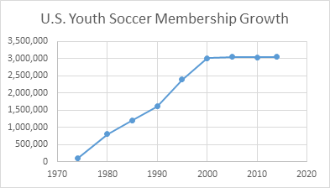
Understand the Bridging the Gap Concept
Stagnated Growth

Slide 4
Understand the Bridging the Gap Concept
Demand Exists
10.2 million children participate in afterschool programming
Nearly 1 in 4 families (23%) has a child enrolled in afterschool programming
19.4 million children (41%) not currently enrolled, would be enrolled if a program were available to them
* Data from Afterschool Alliance National Report
* List of Youth Serving Organizations above is not all inclusive
4,000,000
9,000,000
1,000,000
1,200,000
360,000+

Slide 5
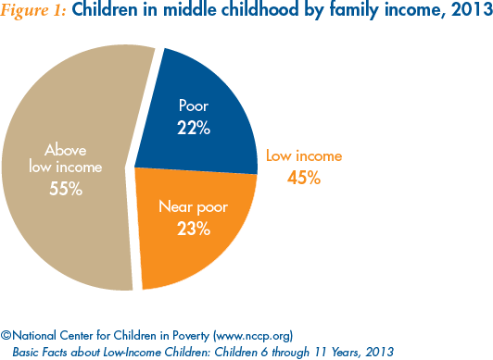
Understand the Bridging the Gap Concept
Increase Accessibility

Slide 6
Defining “Bridging the Gap”
Financial: growing discrepancies in resources available to youth serving organizations between the ends of the financial spectrum
Cultural: challenges of traditional youth soccer models to apply to all communities outside of the upper/middle class suburbs
Programming: discrepancies in programming made available to different communities at all levels of play (youth/adult, recreational/competitive)
Inclusion: lack of diversity in leadership roles guiding youth soccer on local, regional, state, and national levels
* Courtesy of Nick Lusson, ED, NorCal Premier Soccer Foundation

Slide 7
Mapping Partnership Opportunities
Leveraging Partner Resources to Address the Gap
What is your “sphere of influence”?
What is your “community”?
Who are your current/ potential partner(s)?
What are your current/ future goals?
What are the current/ future goals of your partner(s)?
Where do they align?

Slide 8
Mapping Partnership Opportunities
Leveraging Partner Resources to Address the Gap

Slide 9
Mapping Partnership Opportunities
Leveraging Partner Resources to Address the Gap

Slide 10
Leveraging Partner Resources to Address the Gap
Determine barriers and discuss potential solutions
Successful examples from the audience
Examples of current obstacles faced in the process
Determine 2-3 immediate next steps

Slide 11
Q&A
Robert Poretti: rporetti@comcast.net
Marc Maxey: maxkick@yahoo.com
Sarah Pickens: spickens@ussoccerfoundation.org
Take note! Join us at the 2017 Urban Soccer Symposium for more in depth dialogue - April 27-30, Washington, D.C.!
ussoccerfoundation.org/events/urban-soccer-symposium/

