Slide 1

PUBLIC RECORDS AND CRIMINAL BACKGROUNDS
Understanding the Differences

Slide 2
Speaker Biography
Hans William Pauling, Esq., is employed by the Fifth Circuit Solicitor’s Office as an assistant solicitor responsible for the prosecution of criminal cases in Richland County South Carolina. He has practiced law in South Carolina for over sixteen (16) years.
In 2012, Mr. Pauling became the President of the South Carolina Youth Soccer Association. In 2014, he was a member of the US Youth Soccer Governance Task Force and is currently a member of the US Youth Soccer Risk Management Committee.

Slide 3
What is a Public Record?
A public record is information available to the public on any person whose data is currently displayed in a court of law in any jurisdiction in the United States. These courts can include summary court, municipal court, circuit court, family court or other courts such as appellant or Supreme courts.

Slide 4
How do you find public information?
Many organizations employ the use of background check vendors to provide information on volunteers- coaches, parents, administrators and trainers. These vendors use biographical data to search thousands of data bases for individual information deemed helpful to the organization. Primarily this will be criminal information.

Slide 5
How accurate is the vendor information you receive?
The argument that you get what you pay for seems very applicable in the Public Information search. If you are quoted a very low price then it is important that you determine exactly what information you will receive. It does not mean that a low cost vendor is not useful since many times the organization must follow-up on any “hits” from an individual search.

Slide 6
What is a “Hit”?
Hit: a term used to identify a criminal arrest and/or conviction which requires some additional research. The additional research may be necessary to determine the actual outcome of the charge which may not be correct in the public records search or on an actual criminal background check.

Slide 7
What is the difference between a Public Record and Public Index Search?
A Public Record search will use a name, date of birth, gender and part or whole of a social security number to pull in as much data available on the subject. The more you pay for the service the more information is employed to gather the data thereby limiting the need for additional follow-up.

Slide 8
Public Index Search
A Public Index Search is very specific to the jurisdiction in which a subject resides or has previously resided or where he/she was charged or a listed party to an action (divorce/civil claim). Generally this will be a county level public index search.

Slide 9
Some states offer free Public Index searches
http://www.sccourts.org/caseSearch/

Slide 10
Basic Provisions applied to State level Criminal Background Checks and employment (example Georgia)
            3121 Panthersville Road
            Georgia Crime Information Center
            Decatur, GA 30037
            (404) 244-2639
            Criminal History Record
Produced on [date]:
The information in this rap sheet is provided subject to the following caveats.
This response is being produced for your request send [Date] (GA; 2006-11-08).
Important! Criminal history record information is obtained one of two ways:
1. by conducting an inquiry using personal identifiers such as name and date of birth
(name search), or
2. by submitting fingerprint cards to the Georgia Crime Information Center (GCIC).
When conducting a name search for criminal history record information, there is a possibility
that the information returned belongs to a different person with the same, or similar,
identifiers. In this case, a positive match of the person whose criminal history record is
sought requires submission of fingerprint cards to GCIC.
When conducting a fingerprint search for criminal history record information, the
information returned does, in fact, belong to the individual. In this case, conducting a name
search using the individual's personal identifiers would be the same information. (GA; 2006-
11-08)
When the information contained in a criminal history report causes an adverse employment
or licensing decision, the individual, business or agency making the decision must inform
the applicant of all information pertinent to the decision. The disclosure must include
information that a criminal history record check was conducted, the specific contents of the
record and the effect the record had upon the decision.
Failure to provide all such information to the person subject to the adverse decision is a
misdemeanor offense under Georgia law. Additionally, any unauthorized dissemination of
this record or information herein also violates Georgia law. (GA; 2006-11-08)

Slide 11
Common Definitions
Dismissed/Dismissal- State did not go forward on prosecution
Nolle Pros (not prosecuting)-State did not go forward on prosecution at the time
Leave to Reinstate- see above
Diversion- defendant entered into a program following a guilty plea or before a plea was entered. Generally, if program was entered into before plea and successful, this case is expunged.

Slide 12
Diversion Programs
Pre-trial Intervention (PTI) is a common designation for a program that is entered into before a guilty plea is taken. These cases are generally expunged following successful completion if the applicant has followed up and paid for the expungement. If the individual has not paid for expungement then the arrest will still be on their criminal record.

Slide 13
Alcohol Education Program
AEP- generally applies to persons between the ages of 17 years and 20 years old. It is a diversion program directed to keep those young alcohol offenders out of the court system. It is very popular in college communities.
Why participate? Avoid permanent criminal record, driver’s license suspension and possible loss of scholarship of financial aid.

Slide 14
Other Post Plea Diversion Programs
There are diversion programs after a guilty plea has been entered. The two most common are Conditional Discharge for low level first time drug offenses and Court Supervision.
Conditional Discharge requires successful completion of a court order over a specified period and upon completion the charge will be dismissed. Guilty plea is held in abeyance pending outcome.

Slide 15
Court Supervisions
A person enters a guilty plea and while monitored by the Probation department is required to perform activities such as random drug test, community service hours and/or other activities tailored to the offense. If successful the charge will be dismissed. If unsuccessful then the guilty plea is entered into the Public Index.

Slide 16
What am I looking for when I get a “hit”
If you get a “hit” then you need to follow-up and verify the record if you are going to deny participation. Do some leg work. Or if you are from a large state then request the applicant provide a National Criminal Information Center check or NCIC.
NCIC checks are done by fingerprint at the local Sheriff office or state law enforcement division. These are the most accurate backgrounds and cost between $15-$30 each.

Slide 17
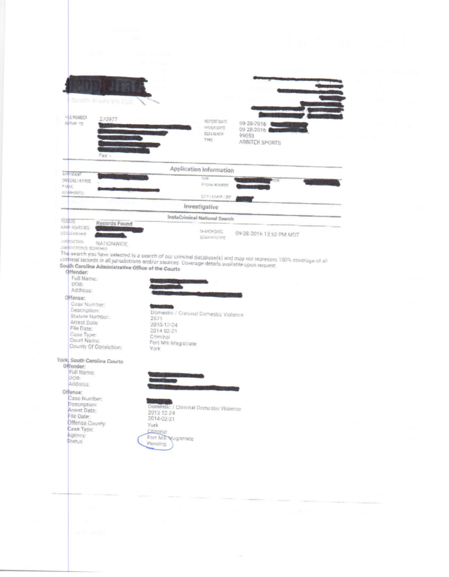
Comparing Public Record Information with actual Public Index Information

Slide 18
Public Index Information
No charge for Domestic Violence was pending. However, there was a divorce action filed whereby the plaintiff stated that the grounds for the divorce were based upon an act of domestic violence. This Family Court Order is a public record available for anyone to access.
What would your State do if this information was discovered?

Slide 19
NCIC Search compared to Public Index Search
The person seems to have almost no criminal history. The NCIC record ( RAP sheet) shows only a Trespass in 2009. This is a misdemeanor punishable up to 30 days or a fine. However, when we exam the actual Public Index we get a very different view of this person. None of these charges independently may exclude this person from participation but collectively do you want them to be a volunteer in youth sports? What would your organization do ?

Slide 20
How do people fall through the cracks?
Police officers have some discretion in making an arrest. When a person is arrested then the suspect is fingerprinted (booking) and that print is entered into the Automated Fingerprint Information System (AFIS) for comparison with other unsolved crimes. However, sometimes the officer will field book the suspect by giving them a traffic ticket with a court date, especially in Possession of Marijuana cases. There will be no arrest record. Even if the person pleads guilty, the conviction may not be readily accessible.

Slide 21
Can you learn everything about an individual?
Most of the time, you can access information that will help your organization make an informed decision. However, there may be instances where you simply cannot know the criminal past completely based on a Public Records check. In those instances where more clarification is required then an NCIC check with additional follow-up is recommended.

Slide 22
Risk Management Disqualifications
Question and Answer period concerning your state association policies.
Becky McLaren tpapenquin@gmail.com
Jim Eleftherion Jelef@insurancemre.com
Hans Pauling paulingh@aol.com
US Youth Soccer Risk Management Committee

