Slide 1
Scoring Goals with Social Media
An Inside Look at Promoting Effectively

Slide 2
Welcome from Jenna Communications
Notes:
Explain Jenna Communications, what it is, how you got started and talk a little about yourself. Talk about how IMPORTANT social media is to PR and to everyday life.

Slide 3
#Tweeting!
Follow me on my personal twitter:
@JennyBentley
Follow Jenna Communications on twitter:
@JennaComm
Use: #15workshop
Notes:
Explain how you use Twitter for Jenna Comm. How we promote people, events, etc. (*we will go into depth with how THEY can use twitter in later slides to come)

Slide 4
Instagram
Follow me on my personal Instagram:
JenniferSherlock
Follow Jenna Communications on Instagram:
JennaComm
Notes:
Explain how you use twitter for your personal accounts and Jenna Comm. (*Again, we will go into detail about how they can use Instagram to connect and interact)

Slide 5
Facebook
Find us on facebook!
Jenna Communications:
Notes:
Explain how you use your personal and business facebook. Explain networking and how you reach your audience. (**Again we will go into detail about how they can use their facebook and facebook fan pages to connect and interact in previous slides to come)

Slide 6
Snapchat
Add Jenna Communications on Snapchat!
Notes:
Explain Snapchat. How it’s evolving. Explain how you can use snap chat for Jenna Communications. (For example how we can take picture of our events for clients and how potential clients have an inside image of what Jenna Communications is capable of doing.) If we have an event in Maryland, South Jersey, etc. clients and friends have the opportunity to come to our event if they are near the location.
* Players can engage on Snapchat by taking pictures of pre/post game activities for parents. *Coaches can create a snapchat account for parents and players. Parents and Players can connect and engage with pictures and videos.

Slide 7
Where Should YOU Begin?
Social media is everywhere! So, how do you begin?
Do your research!
Before you even post, Tweet, Instagram or Snapchat know your audience. You have to identify the key audiences you are reach out to.

Slide 8
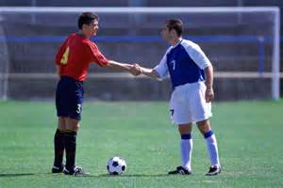
Once You Have Identified Who You Want To Reach
Now, it’s time to figure out what you want to say.
Strong, effective messaging is highly important on social media
The average teenager has 300 friends on Facebook, and likes about 40 fan pages
That means you’re up against stiff competition with all those status updates!
Notes:
Tell a personal story or about what Jenna Communications does to create effective messages.

Slide 9
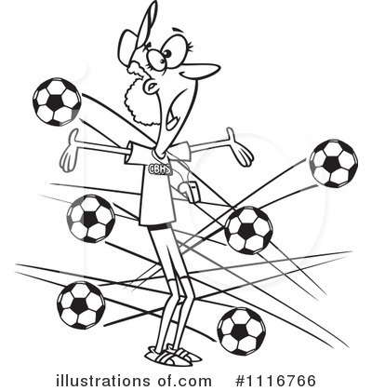
How Do You Make Your Message Stand Out?
It’s ALL about having a strong call to action.
You want to “dare” your viewers to find out more details.
Use and appealing visual to accompany it, as you will see in all our visuals.

Slide 10
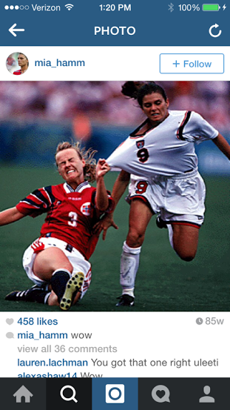
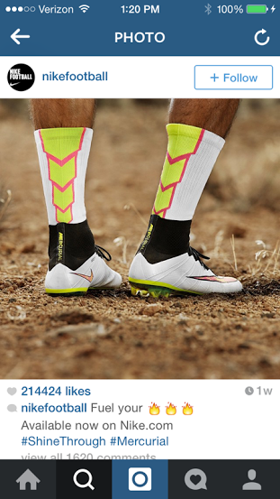
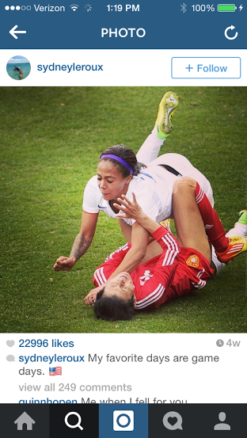
Some Good Examples

Slide 11
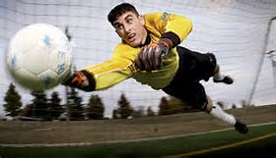
Don’t Forget To Make Goals
The best way to keep yourself focused on social media is to make goals.
It’s one of the first things we do when we begin a new client partnership
Sample goals include growth figures, frequency of posting, maintaining consistent messaging

Slide 12
What Networks Should YOU Be On?

Slide 13
Let’s Start With Facebook!
If you haven’t done so already, create a Fan Page for your league
Treat Facebook as your “control center” and branch out from there
Designate a team as admins to manage the page
Develop a social media routine
Notes:
Now explain how parents, coaches and players can connect through facebook. For example, on the team’s fan page bring up the option of creating a “player of the week” or each month have a “most improved player”. This way parents can connect, share personal stories about specific games that player did well or post pictures of that player. You can list more examples but this is just an example to show how all three parties (players, parents and coaches) can all engage and interact through a social media account.

Slide 14
Let’s Start With Facebook
Remember to create Facebook events for tryouts, signups, etc. to generate buzz
Invite as many relevant people as possible to join event
Keep those who joined your event pumped up by writing exclusive updates
Make an attempt to welcome new guests

Slide 15
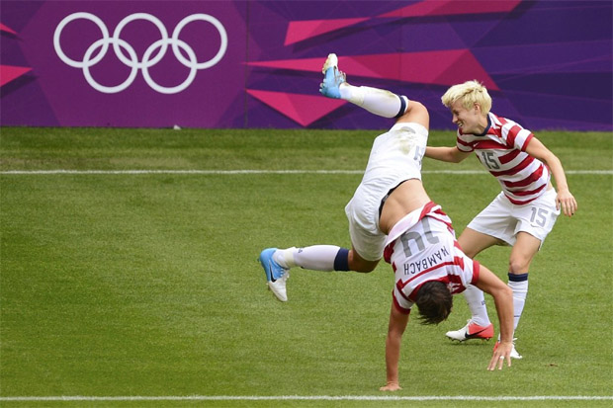
Visuals are POWERFUL
Facebook posts that use visuals get 53% more likes
Make photo albums from tryouts, championships and more
Use photos throughout the year to promote your league
Notes:
Express how coaches should share videos and pictures. (Parents love videos and pictures of their kids and coaches love showing off their team, especially to rival teams or to show how talented THEIR players are.) Parents can “share” these videos and pictures on facebook. This engages in a different audience which is their own social media. This way when the parents “share” these images or videos they can connect with their own families and friends and update them on their children. Players can “share” videos and images on their on social media to connect with their own audience. This can help the team bring in other players or making people want to attend their games. Coaches and parents love when there is a big crowd watching their players and children. It’s all about an ego boost.

Slide 16
*If You Have A Budget*
Facebook allows you to advertise or promote posts for as little as $5 a day.
Facebook ads appear in right hand corner and can only be a max of 90 characters
Promoted posts appear in people’s timelines and will say sponsored.
Visuals are highly recommended with a promoted post
Notes:
Explain how we advertise for Jenna Communications and all the options they have for payments and advertising.

Slide 17
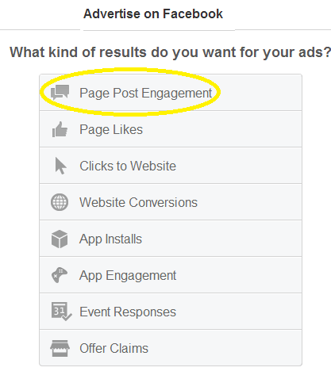
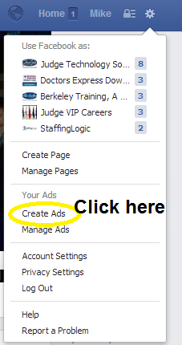
A Quick Look at Making an Ad
Notes:
These next three slides basically explain how to make an ad with visuals. Just explain how they can make an ad. Take them step by step.

Slide 18
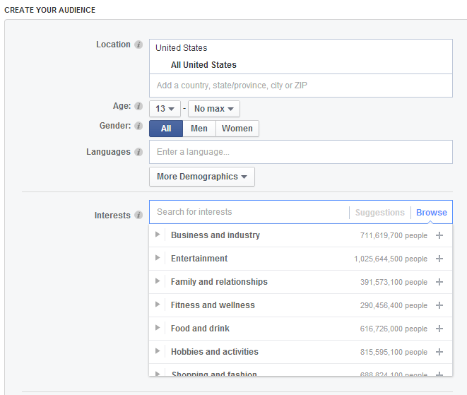
Making an Ad Continued

Slide 19
Finishing Your Ad

Slide 20
Closing Thoughts on Facebook
It’s more about the quality of likes than the number of likes!
Be aware of your “talking about this” number
Visit http://likealyzer.com/ to check how your page is doing

Slide 21
Twitter Talk!
Use Twitter as a tool to amplify your promotional efforts
Follow any relevant people, businesses, schools, municipalities
Create a hashtag # for your events
For example, today’s event hashtag is #15workshop
If you tweet with hashtags, you are 3 times more likely to get retweeted
Notes:
Re-address twitter. Next slide (in the notes section) explains what to say and has some ideas for parents, coaches and players.

Slide 22
Twitter Strategies
Use organizations with large followings to help you
While Twitter allows 140 characters in tweets, it’s always better to use less than that.
Find fans to tweet about different league games and provide real-time updates
Don’t forget to appear like a human being on Twitter
Notes:
Twitter helps parents to engage with their kids and coaches on twitter. Parents can use twitter to tweet to engage with other parents. For example tweeting live updates on games. For the parents that perhaps couldn’t make a certain game they can know the score and what is happening on the field without being there.

Slide 23
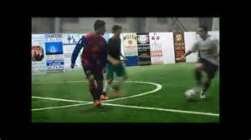
Use A Video!
Video is most engaging for an audience
Make a promotional video for your soccer league to encourage signups
It works well to start a YouTube channel and share from there
Notes:
Use a YouTube video to promote your soccer team. Whether it’s highlights of a game, warm-up, practice or a particular player it engages your audience and allows players to connect as well as parents and coaches. ****This will help if and when a player in getting recruited. Colleges not only want to see a player in person at a game but this gives the player opportunities to send colleges highlight videos of their best games. Also, this gives players the opportunity to stay in touch with recruiters, send them personal videos of their workouts, practices and lifting workouts (lifting is important once you get to college, every player will start a lifting program whether you are a boy or girl if you play D2 OR D1, usually D3 schools aren't as lienent with lifting programs.

Slide 24
Try LinkedIn!
Although it’s predominantly used in the corporate world, you can still use LinkedIn to your advantage
Start a league LinkedIn page to use as a recruiting tool
Encourage coaches/referees to follow your league LinkedIn
Post about all your major upcoming events
Start a LinkedIn group to go along with your page
Notes:
Explain Linked In and how Jenna Communications uses Linked In and how the parents and coaches can use Linked In.

Slide 25
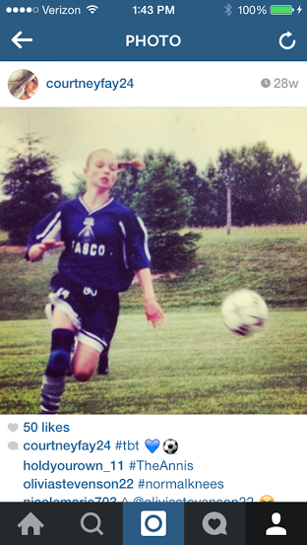
Instagram!
Use photos that are shocking and exciting!
Add a video
Try using Flipgram!
Notes:
Coaches can create a personal Instagram account for their team. They can upload pictures of coaching staff, players, practices, game outcome and some overall fun team pictures. Parents can send pictures of their children to the coaches. Have a #flashbackfriday (#fbf) post each week of when players were younger. Engage both players and parents.
(Explain flipgram)- Use flipgram for game highlights or personal player highlights.

Slide 26
Take Advantage of What’s Already There!
Another promotional habit to get into is making event postings
Many local media outlets have online event calendars
Put together a list of relevant outlets and post away
Often times, you can even get the media outlet to share your info on social media

Slide 27
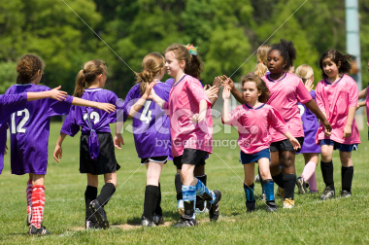
Closing Thoughts
Find assets you have that will make social media work for you
Get into a routine
Be proactive and consistent
Don’t forget to be yourself and appear human

Slide 28
Questions?
My contact info:
Jennifer Sherlock
Email: jsherlock@jennacommunications.com

