Slide 1
Scoring Goals with Social Media
An Inside Look at Promoting Effectively
Notes:
To add slides with this background right click on image in left pane and choose duplicate slide.

Slide 2
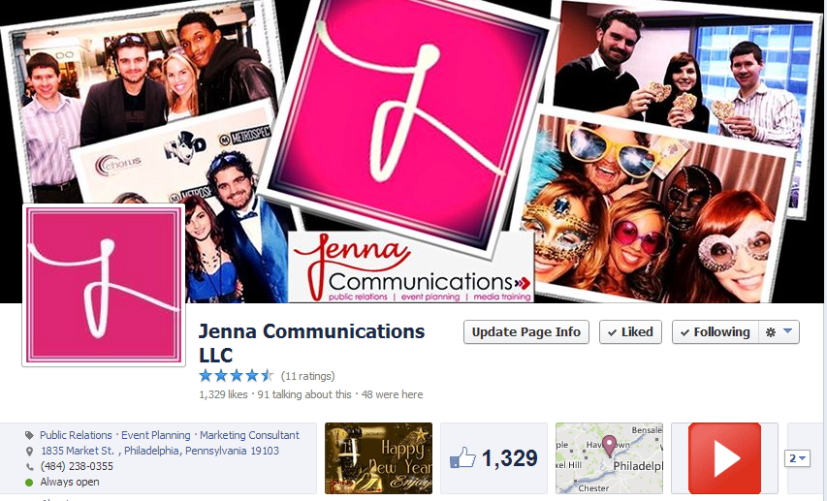
Welcome from Jenna Communications
Notes:
To add slides with this background right click on image in left pane and choose duplicate slide.

Slide 3
Tweet!
Follow me on Twitter @JennyBentley
Follow Jenna Communications on Twitter @JennaComm
Use #scoringgoalswithsm
Notes:
To add slides with this background right click on image in left pane and choose duplicate slide.

Slide 4
Where Should I Begin?
Social media is literally everywhere, so how do I get started?
Before you make one post/tweet, start by doing a little homework
Identify all the key audiences you want to reach on social media
Notes:
To add slides with this background right click on image in left pane and choose duplicate slide.

Slide 5
I’ve Identified Who I Want to Reach
Now, it’s time to figure out what you want to say
Strong, effective messaging is highly important on social media
The average teenager has 300 friends on Facebook, and likes about 40 fan pages
That means you’re up against stiff competition with all those status updates!
Notes:
To add slides with this background right click on image in left pane and choose duplicate slide.

Slide 6
How Do I Make My Message Stand Out?
It’s all about having a strong call to action!
You want to “dare” your viewers to find out more details
Use an appealing visual to accompany it, as you’ll see in our examples
Notes:
To add slides with this background right click on image in left pane and choose duplicate slide.

Slide 7
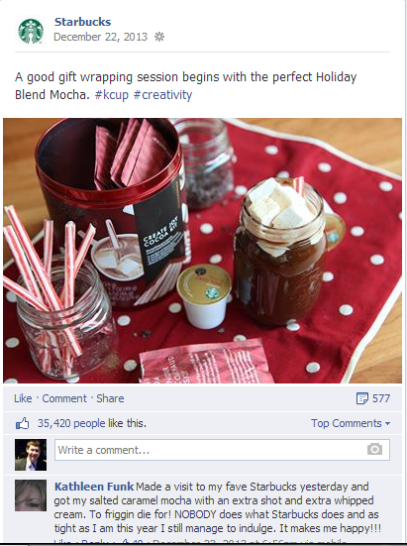
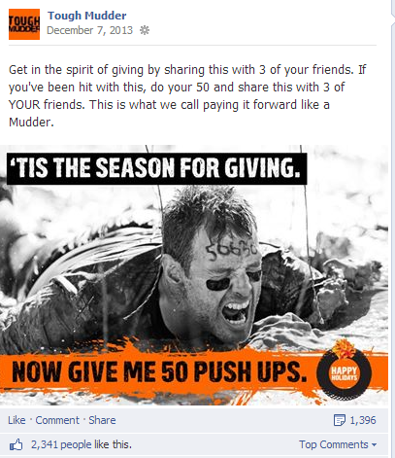
Some Good Examples
Notes:
Compelling photo
Good call to action. Encouraging to sign up/buy.

Slide 8
Apply This Strategy to Your Needs
Rather than saying, “Soccer tryouts are Saturday from 9 am to 12 pm at the high school.”
Try, “This is your chance to feel like you’re part of the World Cup! Join us for tryouts on Saturday…
Notes:
Ways to frame posts- have a catchy call to action. Proactive post to show how games are fun. Then they may be more apt to share it.

Slide 9
Don’t Forget to Make Goals
The best way to keep yourself focused on social media is to make goals.
It’s one of the first things we do when we begin a new client partnership
Sample goals include growth figures, frequency of posting, maintaining consistent messaging
Notes:
To add slides with this background right click on image in left pane and choose duplicate slide.

Slide 10
What Networks Should I Be On?
Notes:
To add slides with this background right click on image in left pane and choose duplicate slide.

Slide 11
Let’s Start with Facebook
If you haven’t done so already, create a Fan Page for your league
Treat Facebook as your “control center” and branch out from there
Designate a team as admins to manage the page
Develop a social media routine
Notes:
To add slides with this background right click on image in left pane and choose duplicate slide.

Slide 12
Let’s Start with Facebook
Remember to create Facebook events for tryouts, signups, etc. to generate buzz
Invite as many relevant people as possible to join event
Keep those who joined your event pumped up by writing exclusive updates
Make an attempt to welcome new guests
Notes:
To add slides with this background right click on image in left pane and choose duplicate slide.

Slide 13
Visuals are Powerful
Facebook posts that use visuals get 53% more likes
Make photo albums from tryouts, championships and more
Use photos throughout year to promote your league
Notes:
To add slides with this background right click on image in left pane and choose duplicate slide.

Slide 14
If You Have a Budget…
Facebook allows you to advertise or promote posts for as little as $5 a day.
Facebook ads appear in right hand corner and can only be a max of 90 characters
Promoted posts appear in people’s timelines and will say sponsored.
Visuals are highly recommended with a promoted post
Notes:
To add slides with this background right click on image in left pane and choose duplicate slide.

Slide 15
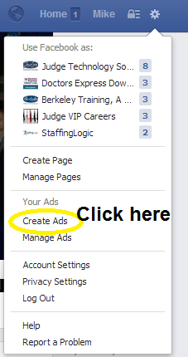
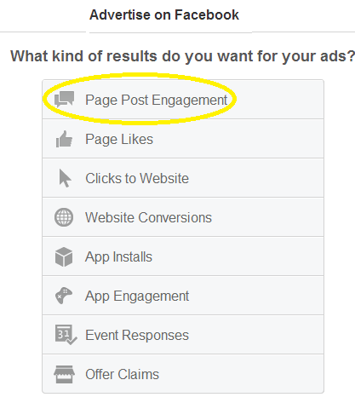
A Quick Look at Making an Ad
Notes:
To add slides with this background right click on image in left pane and choose duplicate slide.

Slide 16
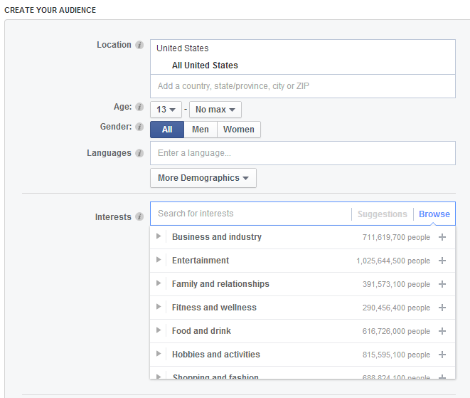
Making an Ad Continued
Notes:
To add slides with this background right click on image in left pane and choose duplicate slide.

Slide 17
Finishing Your Ad
Notes:
To add slides with this background right click on image in left pane and choose duplicate slide.

Slide 18
Closing Thoughts on Facebook
More about the quality of likes than the number of likes
Be aware of your “talking about this” number
Visit http://likealyzer.com/ to check how your page is doing
Notes:
Talk about US Youth Soccer social media number

Slide 19
Let’s Talk Twitter
Use Twitter as a tool to amplify your promotional efforts
Follow any relevant people, businesses, schools, municipalities
Create a hashtag # for your events
If you tweet with hashtags, you are 3 times more likely to get retweeted
Notes:
To add slides with this background right click on image in left pane and choose duplicate slide.

Slide 20
Twitter Strategies
Use organizations with large followings to help you
While Twitter allows 140 characters in tweets, it’s always better to use less than that.
Find fans to tweet about different league games and provide real-time updates
Don’t forget to appear like a human being on Twitter
Notes:
To add slides with this background right click on image in left pane and choose duplicate slide.

Slide 21
Add Video to the Mix
Video is most engaging for an audience
Make a promotional video for your soccer league to encourage signups
It works well to start a YouTube channel and share from there
Notes:
To add slides with this background right click on image in left pane and choose duplicate slide.

Slide 22
A Look at LinkedIn
Although it’s predominantly used in the corporate world, you can still use LinkedIn to your advantage
Start a league LinkedIn page to use as a recruiting tool
Encourage coaches/referees to follow your league LinkedIn
Post about all your major upcoming events
Start a LinkedIn group to go along with your page
Notes:
To add slides with this background right click on image in left pane and choose duplicate slide.

Slide 23
Add Video to the Mix
It’s not a fad!
Strive to use photos that are shocking/exciting
Remember those hashtags! #
Spice it up with some added video
Notes:
To add slides with this background right click on image in left pane and choose duplicate slide.

Slide 24
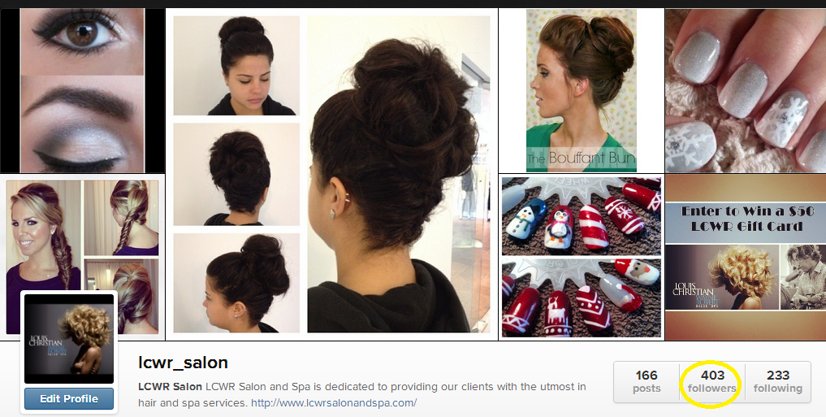
Instagram Example
Notes:
To add slides with this background right click on image in left pane and choose duplicate slide.

Slide 25
Take Advantage of What’s Already There
Another promotional habit to get into is making event postings
Many local media outlets have online event calendars
Put together a list of relevant outlets and post away
Often times, you can even get the media outlet to share your info on social media
Notes:
To add slides with this background right click on image in left pane and choose duplicate slide.

Slide 26
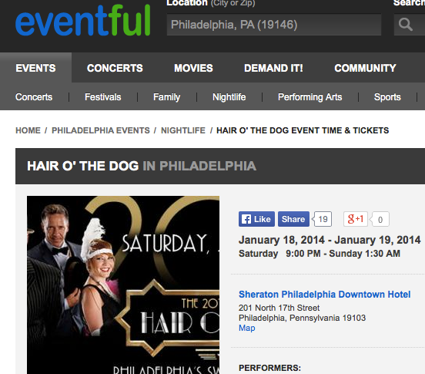
Notes:
To add slides with this background right click on image in left pane and choose duplicate slide.

Slide 27
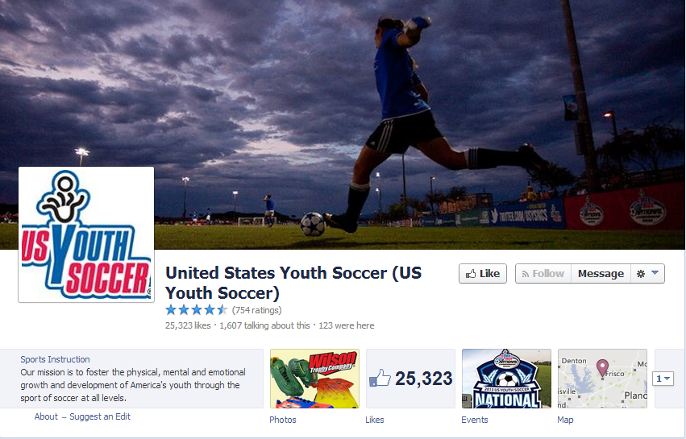
A Quick Review
Notes:
Your Facebook page looks great! The following is strong, and appears to be engaged. You do a very nice job varying your posts as well, and the use of visuals is fantastic!
Only a few minor suggestions that we have. One recommendation I would make is to ask more questions in your status updates. This will help get more comments, and raise your engagement level even further.
One other suggestion I would make is to work in some shorter posts as well. Yes, I realize you have to convey a particular amount of information, but sometimes it’s good to switch things up and post a quick question or inspirational statement. These are some little ways you can boost your engagement.

Slide 28
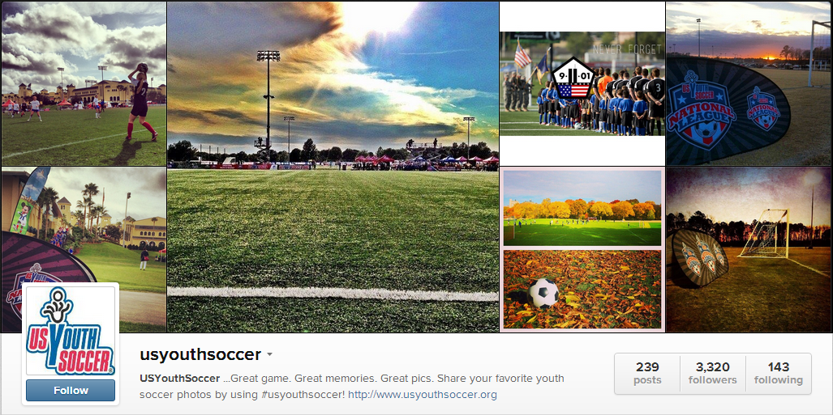
A Quick Review
Notes:
-Your Instagram page is phenomenal. Huge, engaged following.
Great job encouraging fans to use a hashtag #usyouthsoccer when they mention you
One of my only recommendations would be to try and use the video feature a little more. Maybe you could get players/coaches from affiliated leagues to share top plays if they happened to catch them on video. It could be a new outlet to gain even more interaction.
- Also, try to get more soccer leagues to @mention you and share photos. Maybe you could even start a series where leagues share pics with you and you select the top ones and reshare each week

Slide 29
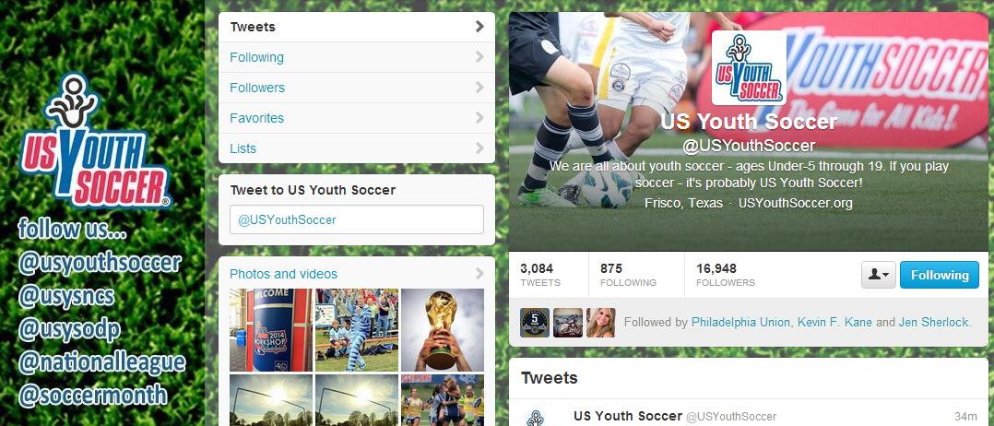
A Quick Review
Notes:
Like Instagram, Twitter is very well done, too. Background is visually appealing, but not intrusive. Also, you include all the different handles that are connected to US Youth Soccer. This is a minor details that often gets overlooked, but not the case in this instance.
Also, you do a great job interacting with relevant organizations and retweeting people who tweet at you. This is important because this is what Twitter is truly all about.
One thing I would work on is more consistent use of hashtags. They are definitely being used, but if you’re tweeting around encouraging someone to vote, for example, I would try to do more follow up and drive home that hashtag so people realize it’s important.
Also, I would maybe try to do more to mention your affiliated leagues and regional divisions. It would be a good idea to maybe participate in #FF (Follow Friday) and mention some these different things. It’s a great to keep people engaged and help build their pages up as well.

Slide 30
Closing Thoughts
Find assets you have that will make social media work for you
Get into a routine
Be proactive and consistent
Don’t forget to be yourself and appear human
Notes:
To add slides with this background right click on image in left pane and choose duplicate slide.

Slide 31
Questions?
My Contact Info
Jennifer Sherlock
jsherlock@jennacommunications.com
Notes:
To add slides with this background right click on image in left pane and choose duplicate slide.

