Slide 1
The Committee Conundrum – Which Ones Do I Need? Shorter Meetings. Better Results.
Ruth E. Nicholson, MPA, CPF
Nicholson Facilitation & Associates, LLC
Youth Sports Services

Slide 2
At the end of this workshop, You will be able to:
Assess the need for a specific committee
Set up and support a committee
so that it can conduct its work successfully
Help board members, staff, and coaches use committees and workgroups effectively,
without micromanagement
1
2
3

Slide 3
Workshop Roadmap
Requirements for a Committee
Committee Links to Leadership and Programs
The Secret to Avoiding Micro-Management
Effective Committee Operations

Slide 4
If you don’t need ‘em, Don’t convene ‘em!

Slide 5
Do I need a committee?
Required in by-laws or articles of incorporation
(Legal requirement)
Project needs multiple skills to implement
(Skills requirement)
Project is large and needs multiple people to implement
(Labor requirement)
Project needs significant community support
(Public Relations requirement)

Slide 6
Links to Leadership and Programs
Define clear roles & responsibilities for every member of your leadership team, including key staff and the board of directors for non-profit organizations
Identify the direct connection of each of these responsibilities to your players, teams, and programs
Convene committees to implement specific work that supports these connections and responsibilities

Slide 7
The Secret to Avoiding Micro-Management
Board Position | Scope of Work | Link to Teams | Committees
President | Board leadership | Source of future board members | Nominating Committee
Treasurer | Uniforms | Team uniform coordinators | Uniform Committee
Club Events | Tournament | Tournament volunteer staffing | Tournament Committee

Slide 8
Committee Charter
Committee Name
Committee Purpose
Names and Specific Roles of All Members
Scope, Responsibility, & Authority
Outcomes, Outputs, & Deliverables
Schedule & Timeframe
Operating Norms & Ground Rules

Slide 9
Example Committee
Name
Members
Purpose
Scope
Outcomes
Schedule & Timeframe
Operating Norms & Ground Rules

Slide 10
Support Committee Success
Establish clear expectations for committee operations
Plan & facilitate effective meetings

Slide 11
Establish Expectations -
For individual members of the committee
For how the committee will
operate and conduct its work
For how the committee will interact with those who are not on the committee

Slide 12
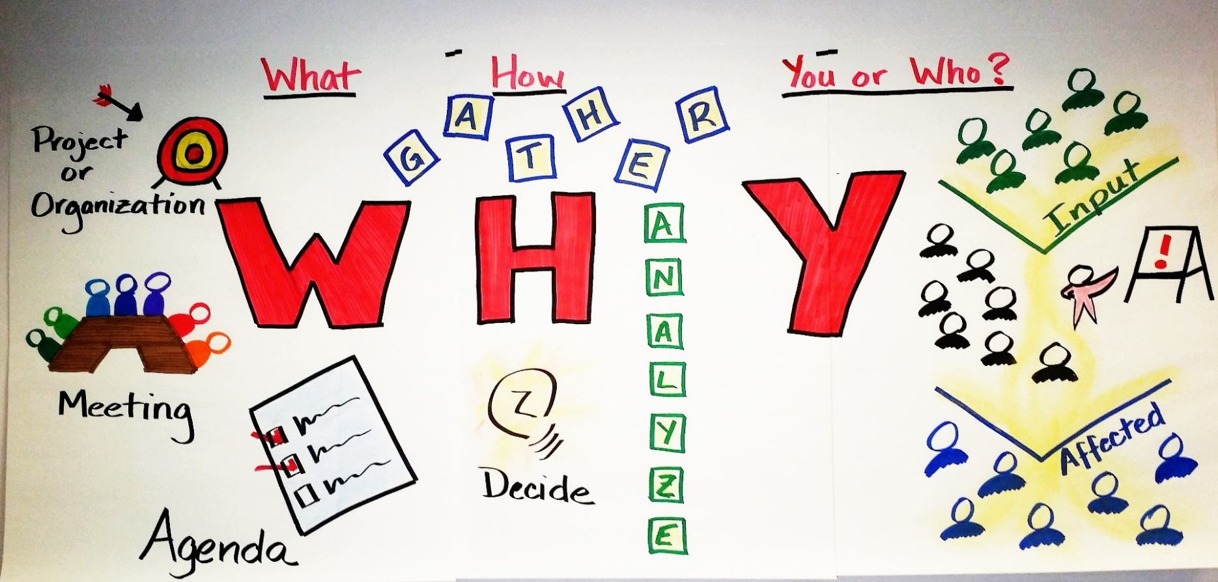
Keys to an Effective Meeting

Slide 13
Project or program
Each meeting
Each item on an agenda
What - The Three Levels of Purpose

Slide 14
How – Three Types of Meeting Activities
Gathering or sharing information
Discussing & analyzing information
Making decisions

Slide 15
You or Who? People Affected by a Meeting
Those with input and information for the meeting
Meeting participants
Those affected by the meeting results

Slide 16
Use WHY to Build Your Meeting Plan

Slide 17
Example: Meeting Agenda
Agenda Item | Topic | Purpose (What) | Activity (How) | Who (Person) | Documents
1 | Budget | Adopt 2017 budget | Discuss & vote on committee proposal | Finance Committee Chair | Draft 2017 budget
2 | Tryouts | Set date for tryouts | Discuss & vote on committee proposal | Tryout Committee Chair | Annual club calendar

Slide 18
Summary
Assess the need for specific committees
Set up & support an effective committee
Avoid committee micromanagement
Ruth E. Nicholson, CPF
Nicholson Facilitation & Associates, LLC
Ruth@NicholsonFacilitation.com
206-369-5439

