Slide 1
Three Keys to Securing a Major Sponsor for your Club
Friday 01/13/2017
1:15 pm - 2:15 pm, CC 501B
Notes:
Saturday 01/14/2017 9:30 am - 10:30 am

Slide 2
Dave Brown
30 + years as a DOC, college, HS & ODP coach plus 25 years grant writing in higher ed, soccer and youth services.
USSF B license, NSCAA DOC certificate, Master’s Degree in higher education
Seattle native

Slide 3
Participant Minute Survey
Volunteer board member or officer?
Club executive director or a coaching director taking on more responsibilities?
Want some tools to take back home to share with/inspire others?
Non-traditional?
Other?

Slide 4
QUESTIONS IN ADVANCE?

Slide 5
Sponsorship Basics
Is sponsorship right for your club?
A great time for youth soccer sponsorship
Profile of the sport: World Cups & Olympics, MLS
Demographics: Parents, grandparents, kids, young consumers
For better or worse, soccer families tend to have more disposable income, are better educated and are consumers (life stage changes)
Notes:
As a family grows, it need for types of cars and homes changes. Kids graduate from toys to electronics. Grandparents look to downsize and to relocate, etc.
Soccer demographics info sources at end of handouts.

Slide 6
Basics (cont.)
What can sponsorship funds be used for?
Good news - unlike charitable grant funds, most anything.
Dollars are fungible.
(We’ll come back to this.)

Slide 7
Key #1: Know Thyself

Slide 8
Your Needs
Examples:
Player scholarships/financial aid
Program enhancements, including player and coach development
Keeping the overall cost of your club affordable to all families

Slide 9
Enhancements
Friday night skill clinics
Enhanced Keeper Training
SAQ/Injury Prevention
Nutrition Education
Positional Training
Community Service Program
A new outreach program to under-resourced communities and families

Slide 10
Internal Preparation: Needs & Assets
Your needs and wants? (Should be a short discussion!)
What do you do that is Sponsor-Worthy?
Perform an Asset Inventory: dissect and quantify your properties: programs, projects, people, media and events

Slide 11
What do you have that is marketable and saleable?
Visibility:
Signage/placement
Field complex, fields
Team shelters
Uniforms
Bags
Shelters and benches
Track-suits, warm-up t-shirts, raincoats, etc.

Slide 12
Events and Programs
Club night or BBQ, annual meeting
Soccer for Success, TopSoccer
Community outreach program
Development/youth/high school/Boys/girls
Coaching education, SAT Prep-Study table, etc.
Manager Appreciation Night
Notes:
60% if donations are made by women 60 years or older!

Slide 13
Media
Website (can you drive and quantify traffic)
Newsletter
Official communications with families, including e-mail
Registration forms
Public service announcements, etc.
School flyers?

Slide 14
Most Importantly
Access and Exposure to Your Members
Demographics by Community
http://www.movoto.com/demographics/
(Additional in Resources Section)

Slide 15
Demographic Information Sources
"Hey, data data -- swing!", The hidden demographics of youth sports (ESPN: http://espn.go.com/espn/story/_/id/9469252/hidden-demographics-youth-sports-espn-magazine
A Study Of World Cup Tweets Reveals Important Insights About the Demographics of Soccer (Business Insider): www.businessinsider.com/world-cup-demographics-2014-7
“Your client at youth soccer tournaments; Kick up buzz with players and families by sponsoring an event”: www.medialifemagazine.com/your-client-at-youth-soccer-tournaments/
Soccer by the Numbers: A Look at the Game in the U.S.
www.nbcnews.com/storyline/fifa-corruption-scandal/soccer-numbers-look-game-u-s-n365601
What Nielsen's 2013 Sports report says about soccer's future: www.lagconfidential.com/2014/2/11/5403042/what-neilsons-2013-sports-report-says-about-soccers-future

Slide 16
Quality v. Quantity
Getting into the homes, hands and heads of prospective customers is valuable in this day of media saturation.

Slide 17
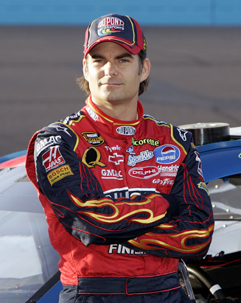
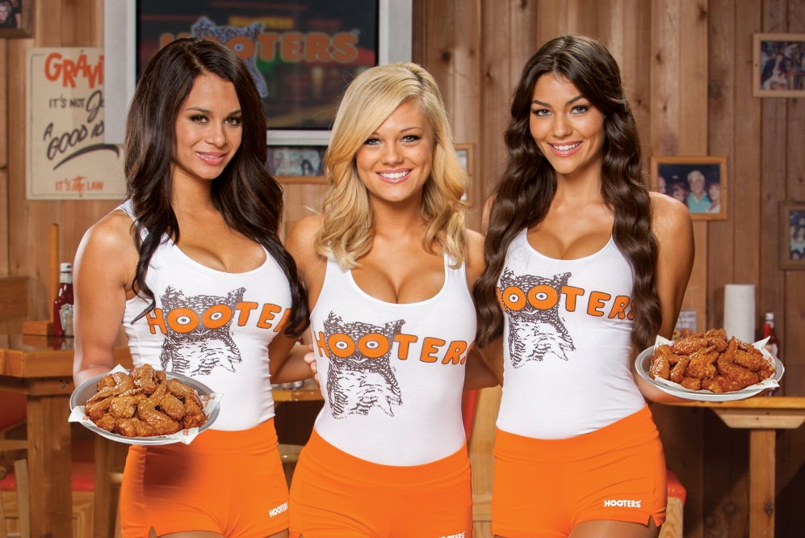
Policies set and documented up front!
Beyond the obvious…
Notes:
Besides the obvious, have policies in place that keep all members on board and going rogue on you! Are there other groups your membership would not want to be affiliated with? Environmental, developers, etc.?

Slide 18
Organizing Yourself
Standing Sponsorship Committee with one person dedicated to Fulfillment.
Not everyone has to “ask” – research, thanks, handle details and logistics, marketing, writer.
One or people do and at least one has to be aggressive and preferable connected. Who in your club will gets his or her calls returned?!

Slide 19
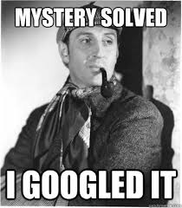
Key 2: Know Your Sponsor
“Ask not what sponsors can do for you, but what you can bring to a sponsor.”

Slide 20
Your Research Objectives
Connections: One of most important is who does business with whom
Prospect’s marketing and sales objectives
New initiatives, target audience(s)
Current sponsorship
Operational areas / geography
Notes:
Google maps (pins) to do a geographic overlay.

Slide 21
Approach: Your goal is a warm call; never a cold call

Slide 22
Detailed Prospect Identification Plan
“5 steps to finding that perfect sponsor.”
http://practicalsponsorshipideas.com/finding-perfect-sponsors/

Slide 23
Marketing vs. Philanthropic Funds
Notes:
Most philanthropic budget decided between October and December. In a larger company with multiple product lines you might be working with more than one marketing team or department.

Slide 24
The Business Sweet Spot
Multinational Corporation (no connection)
Large chain with local presence but headquarters in another state (no connection)
National company with plant or hub in your area
Large public corporation with history of sponsorship you have a strong connection to
Large privately owned business you have strong connection to
Medium privately owned business you have strong connection to
Franchise owner – multiple stores or region
Franchise owner – one large successful unit
In-kind donation of true value
Start up Business: (Single person landscaping vs venture capital backed high tech in competitive market)
New business/brand entering a crowded market
Single franchise owner – new or small
Mom & Pop business

Slide 25
Sample sponsor list from large club in the Greater Seattle area:
Windows Phone (jersey sponsor)
Redapt data center infrastructure and cloud solutions
XXX Soccer Stores
Nike
XXX Health Orthopedic
XXX Mortgage
Notes:
Club is in a position of strength; size, history of success and visibility, geography, demographics

Slide 26
Sample List Continued
XXX Healthcare (BROKERS)
Enterprise rental cars
Alaska Airways Delta Airlines
XXXX Consulting - business and technology consulting firm
Waste Management
Honda of XXX

Slide 27
Sample List Continued
XXX Photography
XXX Physical Therapy
XXX Home Medical
Max Muscle Nutrition
XXX Ridge Physical Therapy
XXX Windermere Real Estate
XXX Windermere Real Estate (2)

Slide 28
Sample List Continued
Yogurt Land
XXX Software - Digital Marketing and Analytics solutions
XXX (RESTAURANT) on Main Street
Ristorante Paradiso
Grand Events Rental
XXX Real Estate
XXX Sports Chiropractic

Slide 29
Other
Banking, financial services
Massage Envy
Insurance
College application guidance service or recruiting services
Nutrition counseling
Maid Service
Visiting Home Care Service
Bottling (Powerade, Gatorade, etc.)

Slide 30
Key #3: The Twain Shall Meet

Slide 31
Contacting Sponsors – When
Typically budgets set by January (decision-making Oct-Dec), but sometimes quarterly or semi-annual requests allowed.
Also funds maybe left over at end of fiscal year.

Slide 32
Speaking the Lingo
Assets – Property – Inventory - Event
Fulfillment - Stewardship
Return on Investment (ROI)
Leveraging - Activation (led and paid for by sponsor)
Cause Marketing (…minimum guarantee)
Co-op: The sharing of sponsorship costs between a manufacturer and distributor or dealer.
CPM (cost per thousand impressions) or CPI
Notes:
Make sure you are speaking the language of your prospects when you communicate with them.

Slide 33
Traditional vs. Underserved Programs
Urban Program Strengths
Traditional Program Strengths
Attractive consumer demographics
Business owners – executives in club
Connections through parents
More control over properties – uniforms, facilities, shelter signage, etc.
Compelling participant demographics
Compelling need & story
Partnerships – including national affiliations
United Way – Day of Caring
“Annual report factor”
Notes:
To add slides with this background right click on image in left pane and choose duplicate slide.

Slide 34
Your Proposal
Purpose, background, need
Why now?
FAQ’s (multiple audiences)
Benefits to the community; benefits to the sponsor
Who we are; demographics
Notes:
Audiences include sponsors, parents, grumpy board members, foundation granters, etc.

Slide 35
Your Proposal (cont.)
Sponsorship levels available
Opportunities available
Tax benefits (fair market value)
Time sensitive - key dates
Contact information

Slide 36
Sponsor Options
Club Sponsor
Event Sponsor
Season or Series Sponsor
Program Sponsor
Presenting Sponsor
Primary Sponsor
Category Exclusivity
Official Supplier…“pre-game sports energy food” vs “official off field snack”

Slide 37
Recognition Materials

Slide 38
Custom Recognition
Meet with prospective sponsor and ask them what is most important to them?
Special features: Cars on tournament site, inclusion of discount or ad in tournament registration materials or swag bag, $ match for test drive, etc.

Slide 39
How to determine value/cost?
Cost + (don’t forget the cost of fulfillment)
Comparative value – who are your peers and what are they charging? What is the industry paying?
Ultimately - what will the market bear?

Slide 40
Corporate Donors and Sponsors
Nature and motivation: marketing vs philanthropic budgets and local vs regional/national budget
to increase sales
to enhance or repair a public image
to boost employee morale
to enhance CEO or board image
to be associated with a mission or cause, project or demographic group
B2B networking
Tangible (event tickets, league registrations)

Slide 41
Types of Sponsorship Proposals
Letter of Inquiry (LOI) - Preliminary Proposal - Letter of Application
Request for Proposal (RFP)/Grant Application
Online screening system
Electronic submission
Notes:
Letter of Inquiry (LOI) - Preliminary Proposal - Letter of Application: “Screening process”; saves both parties time, but needs to be well thought out.
Request for Proposal (RFP)/Grant Application: Most common type of application.
Online screening system: Need to be careful; try and Google actual application form

Slide 42
Expand Your Audience
Think beyond soccer when searching for funding:
Leadership/academics
Girls and women
Diversity/under-served communities
Positive free-time and after-school activities
Childhood health and obesity
Economic development
Other
Notes:
Bank as an example

Slide 43
Traditional vs. Non-Traditional Programs
Traditional Program Strengths
Urban Program Strengths
Attractive consumer demographics
Business owners – executives in club
Connections through parents
More control over properties – uniforms, facilities, shelter signage, etc.
Compelling participant demographics
Compelling need & story
Partnerships – including national affiliations
United Way – Day of Caring
“Annual Report factor”
Notes:
Is a partnership with a traditional program viable or advisable?
What other partnerships are possible?

Slide 44
Understanding Operating vs. Program Funds: How to create programs that don’t cost you money
Fungibility – how to construct or enhance a budget for your “program” or “project”.

Slide 45
Finding Donors

Slide 46
Free and Low-Cost Search Tools
Free and Low-Cost
Guidestar.org
Google Alerts & Advanced Search
LinkedIn
Facebook
Commercial (may be avaialble through work or public library)
Foundation Center Online
Lexis-Nexis, etc
DonorSearch

Slide 47
Sponsorship & Corporate Donations
FDO Search
Google Search
Profile
Chart Grants, Map Grants, Search Grants
Comparison of corporate giving and corporate foundation giving.
Relationship between Corp and Corp FDN
Name of company
+
terms “community” or “social responsibility”, “giving”, “grants”, “sponsorship” or “philanthropy”

Slide 48
Contacting Corporate & Business Funders – Who?
Local vs. national or regional budget. $ and who handles.
Corporate Foundation Staff (in a large corporation)
Community Relations Officer (medium-size company)
HR department/CEO’s executive assistant/secretary (small company)
Owner/CEO/CEO’s executive assistant/secretary (small to medium business)
Your club connection typically knows or can find out who the contact person is.
Research: annual reports, website, local news clippings (Google Alerts)
Notes:
Be nice to everyone you talk to and be ready with your elevator speech at all times!

Slide 49
Retaining Your Sponsor for the Long Term
Start planning now to retain your sponsors for the long-term
Sponsorship Committee with one position dedicated to fulfillment
Simple, manageable fulfillment done well
Work to create multi-year agreements (uniform cycle, etc.)

Slide 50
The Sponsorship Cycle
Notes:
Solicitation or “the ask” is one phase of grantwriting and fundraising.

Slide 51
Simple, Effective Stewardship
Don’t promise the moon but find out what is really important to your sponsor and deliver!
Simple things: Send pictures, invite to events, send them copies when you have included their logos, etc.
They don’t want to be you booty call!

Slide 52
Sponsorship Resource List
Websites
US Youth Soccer Participation Statistics:: http://www.usyouthsoccer.org/media_kit/
“Your client at youth soccer tournaments; Kick up buzz with players and families by sponsoring an event”: http://www.medialifemagazine.com/your-client-at-youth-soccer-tournaments/
Michigan Youth Soccer Association Marketing Program, FY 2013
http://www.michiganyouthsoccer.org/Asset2883.aspx?method=1
Inexpensively Estimating the Economic Impact of Sports Tourism Programs in Small American Cities
http://www.ibrc.indiana.edu/ibr/2015/spring/article1.html
Books
Developing Successful Sport Sponsorship Plans, Second Edition (Sport Management Library) David K. Stotlar (Author)
RESEARCHING PROSPECTS
How to read a 990-PF form: http://www.npccny.org/Form_990/990.htm,

Slide 53
BTW: US Soccer Foundation Presentations
1. Thursday 3:45 pm - 4:45 pm, CC 405
Building Safe Places to Play
Sarah Pickens, Director of Programs, U.S. Soccer Foundation
Paul Jeffries, Director, Community Development, New York City Football Club
2. Saturday 3:45 pm - 5:15 pm, CC 406AB
The Blueprint: Training Coaches as Mentors
Michael Vaughan Cherubin, Senior Programs Manager, US Soccer Foundation
Notes:
Applying for a Safe Places to Play grant is a two-step process. First, you will need to submit a Letter of Interest (LOI) to the U.S. Soccer Foundation's Grants Department. Second, if the Foundation approves the LOI, your organization will be invited to complete an official application.
LOIs are accepted on a rolling basis throughout the year. LOIs submitted according to the following schedule will be considered during each Grant Cycle:
Spring Cycle Deadline: LOIs due by 1/27/17
Summer Cycle Deadline: LOIs due by 5/26/17
Fall Cycle Deadline: LOIs due by 9/29/17

Slide 54
Questions?
Notes:
To add slides with this background right click on image in left pane and choose duplicate slide.

Slide 55
Contact Information
DBCommunications
davebrown2006@comcast.net
360-927-2337
www.linkedin.com/in/dbcommunications

