Slide 1

Youth Injury in Sport
Measure and Reduce Risk with Movement Testing and Programming

Slide 2
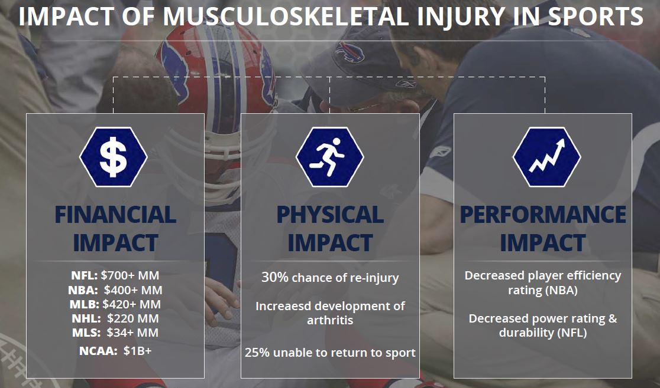

Slide 3

Injury Impact in Youth Sport

Slide 4

ACL Incidence – Young Females

Slide 5
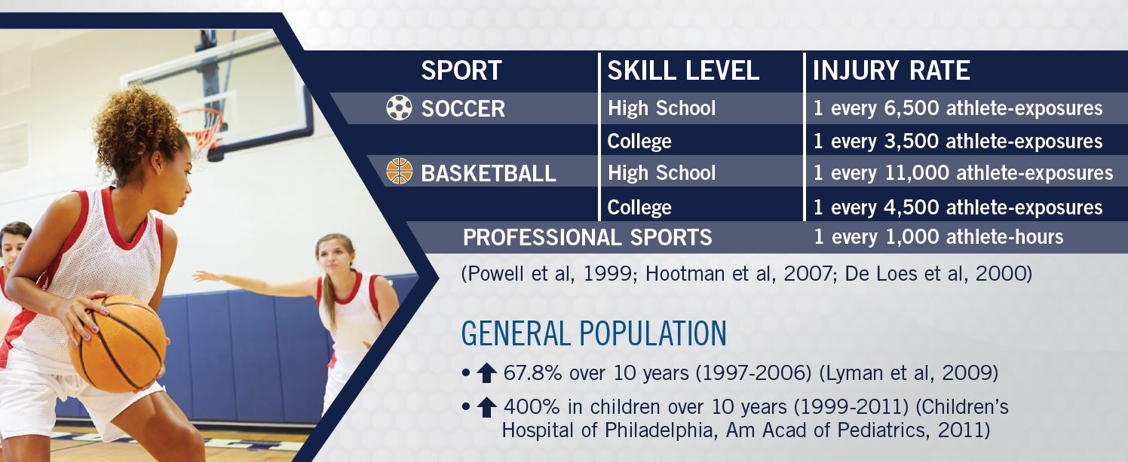
ACL - more frequent at higher levels

Slide 6
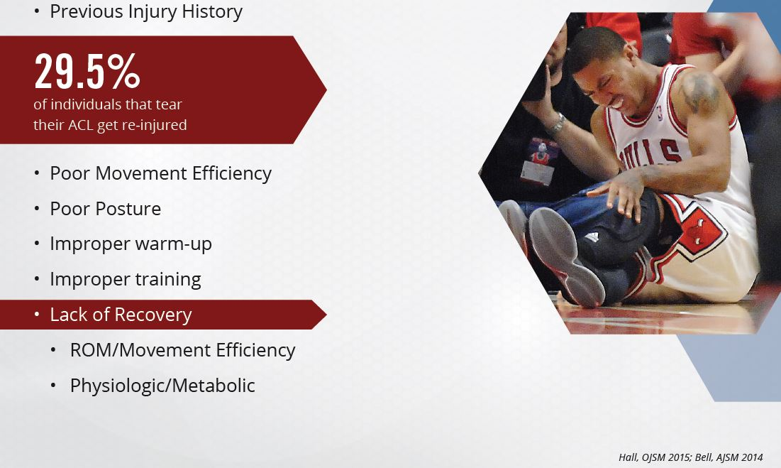
Sources of Injury

Slide 7
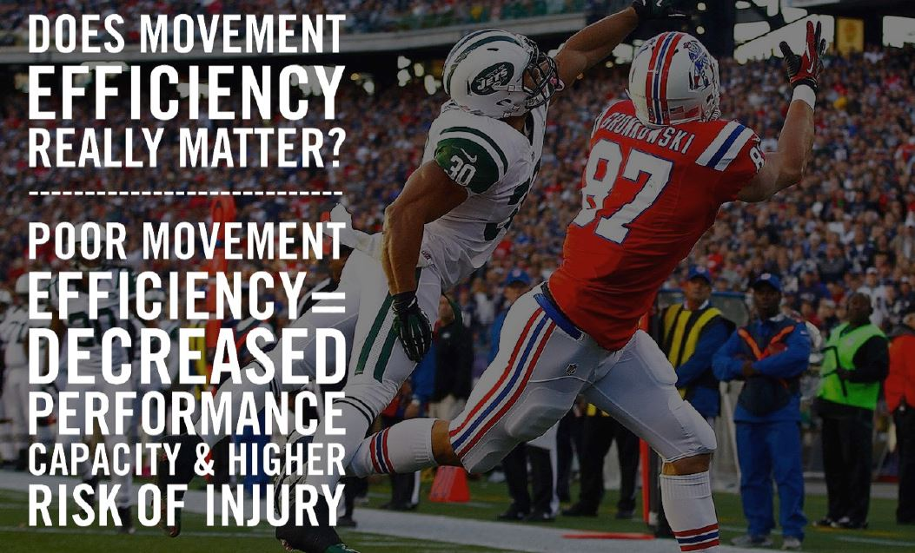
Movement Quality Matters

Slide 8
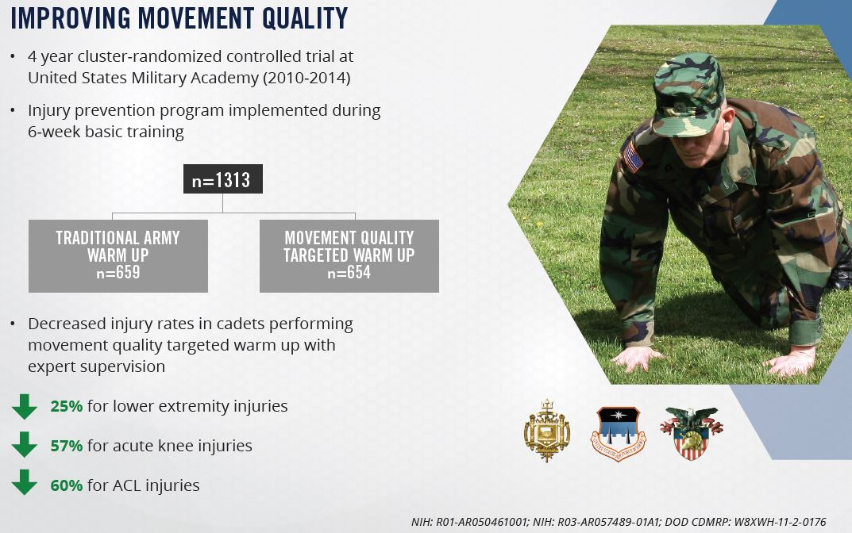
Test and Program Reduces Injury Rates

Slide 9
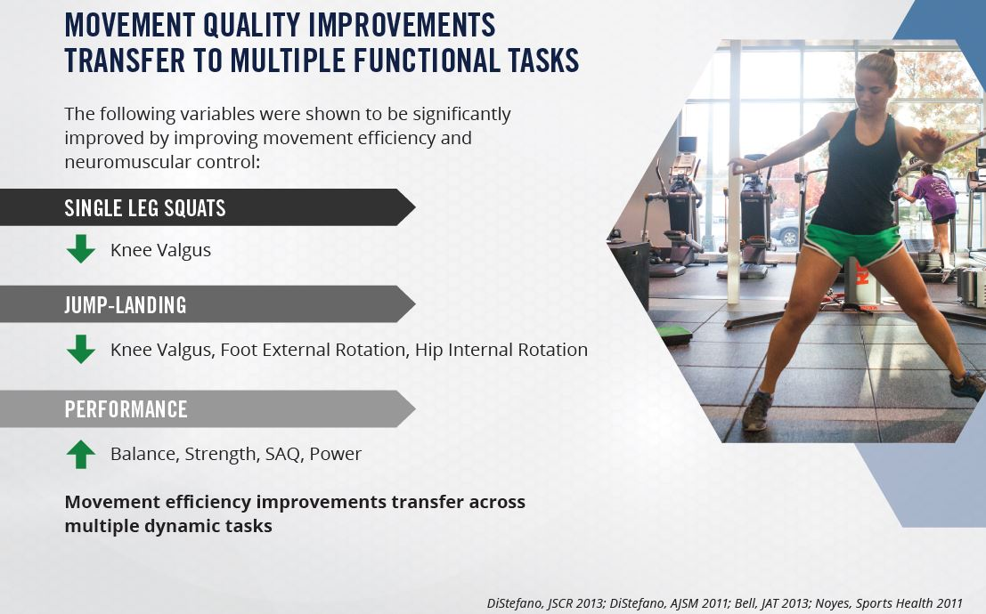
Quality Movement Helps Performance

Slide 10
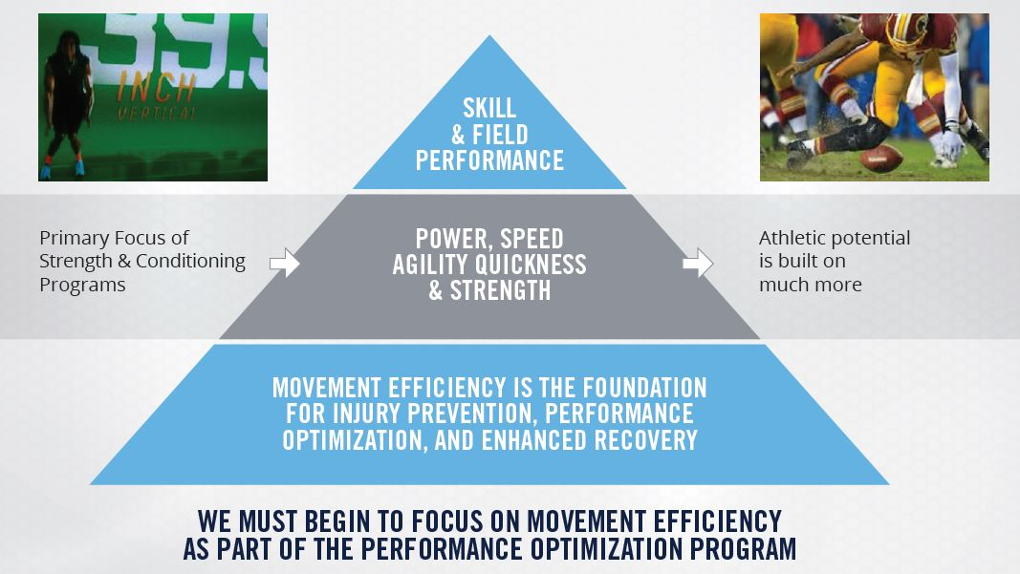
The Foundation Matters

Slide 11
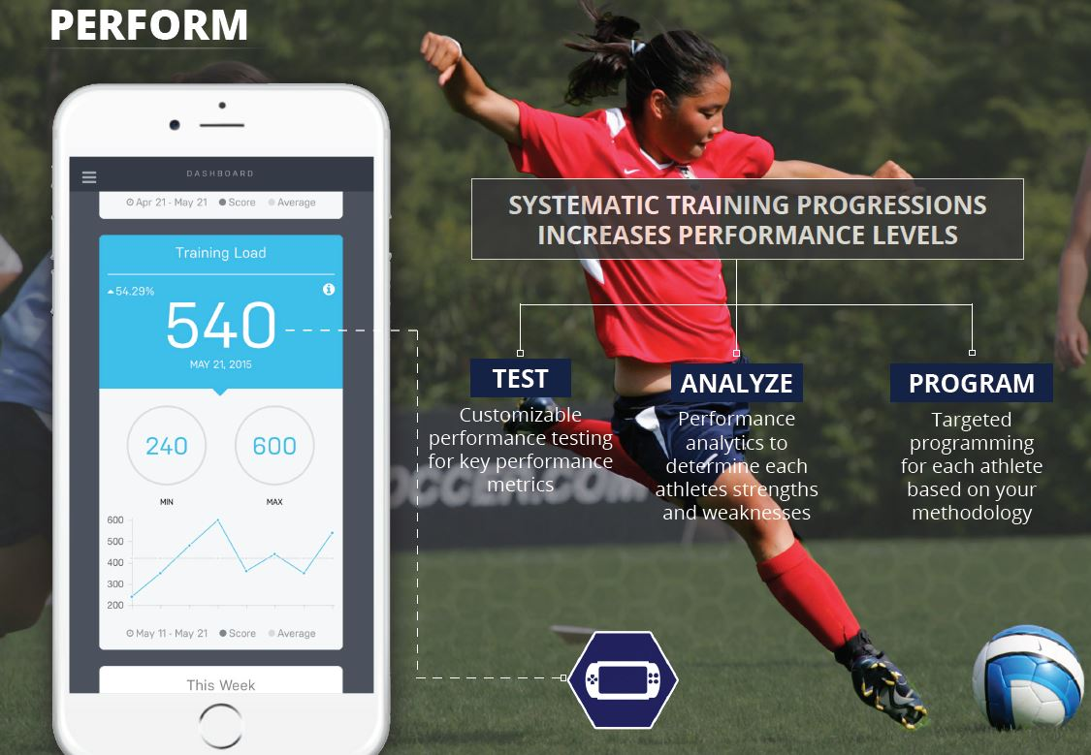
Individualize the Foundation

Slide 12
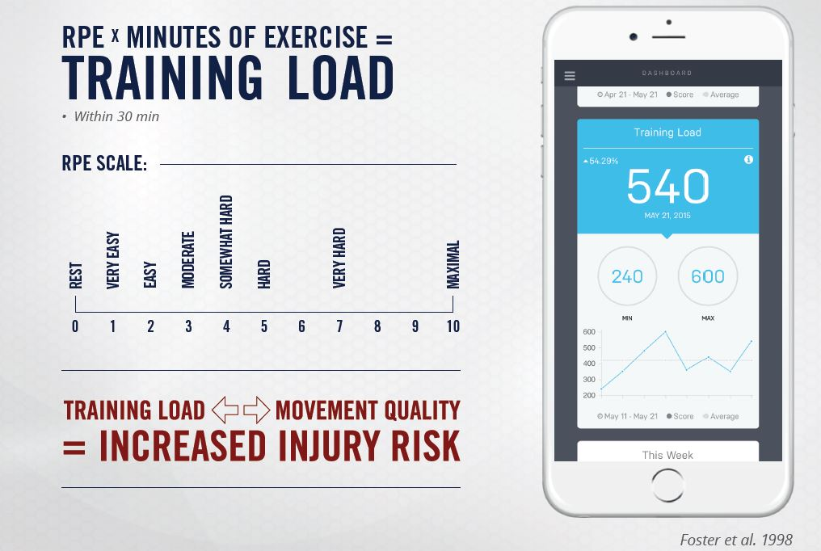
Monitor Individual Training Load

Slide 13
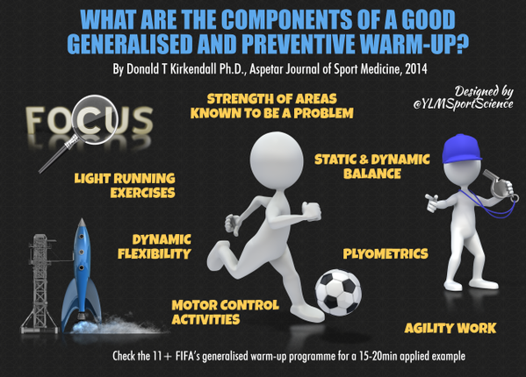
Reinforce in General Team Activity

